Slide 1
Lesson 2: Collage & Mapping
Ms.Kirwan

Slide 2
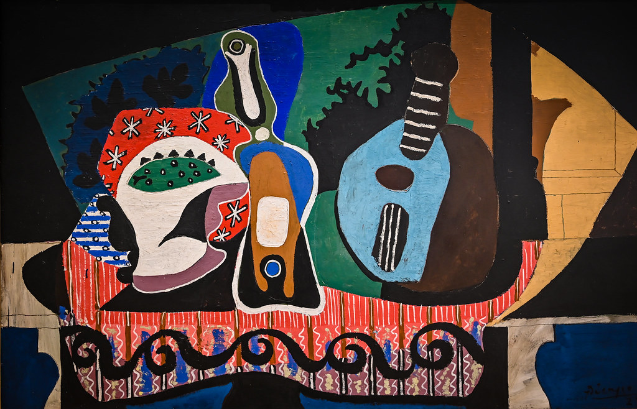
Thinking Time…

Slide 3
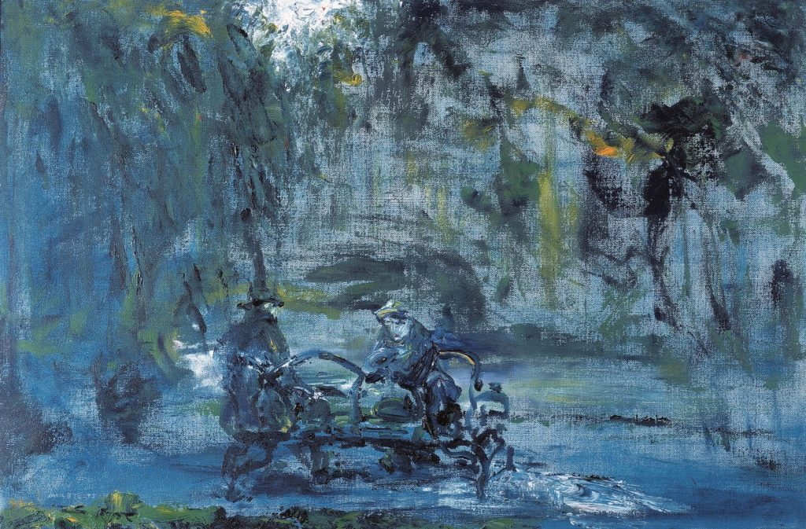
Thinking Time…
Stephen’s Green at Closing Time

Slide 4
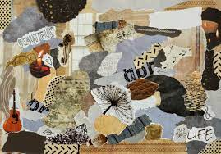
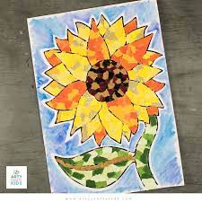
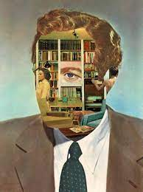
Collage
Can anyone tell me what collage is?
Collage: a piece of art made by sticking different materials such as photographs and pieces of paper or fabric on to a backing.

Slide 5
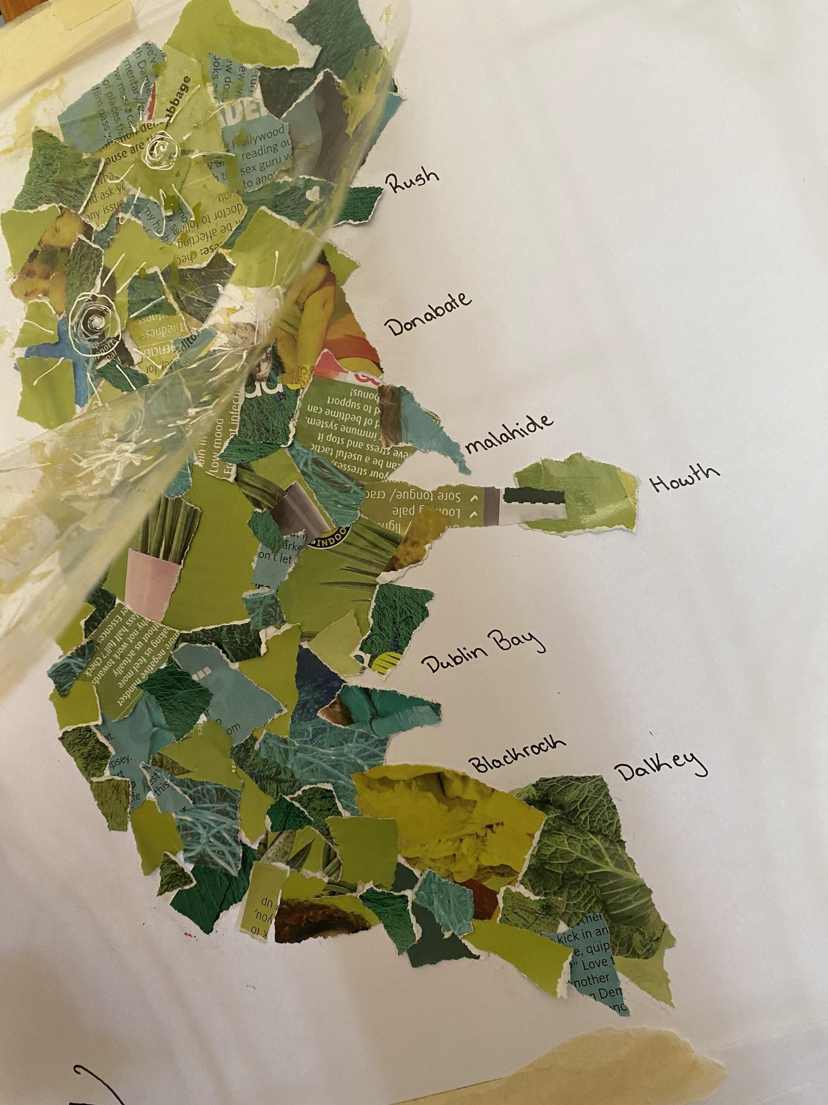
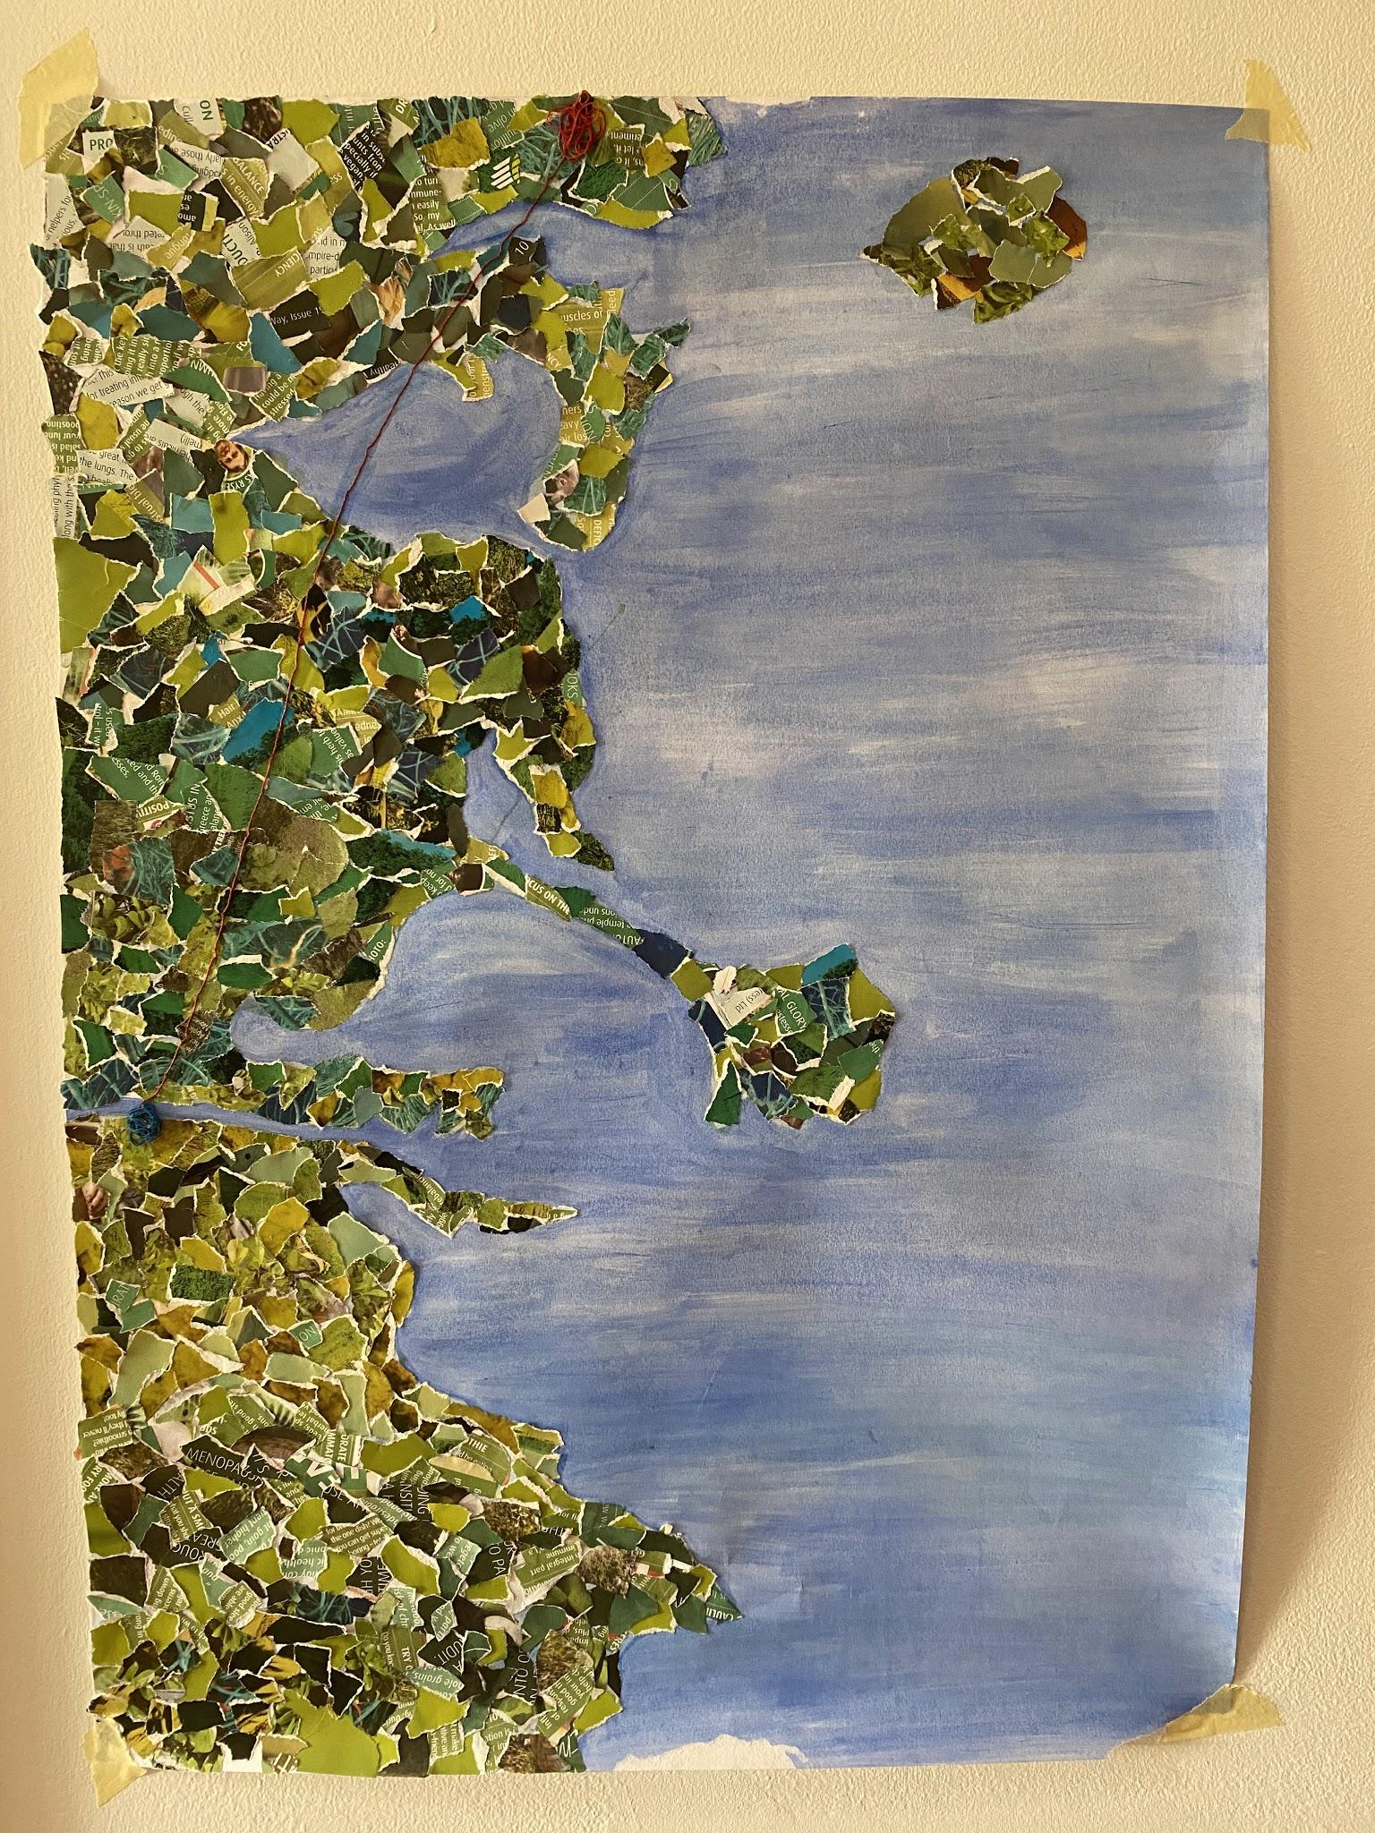
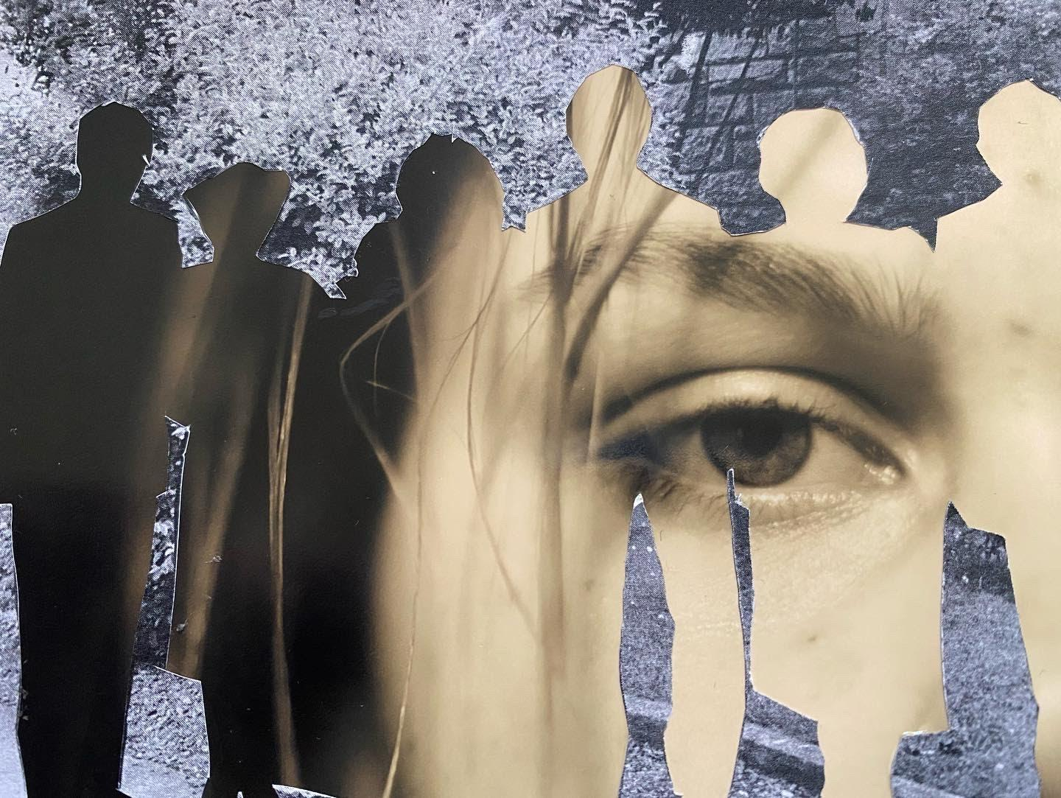
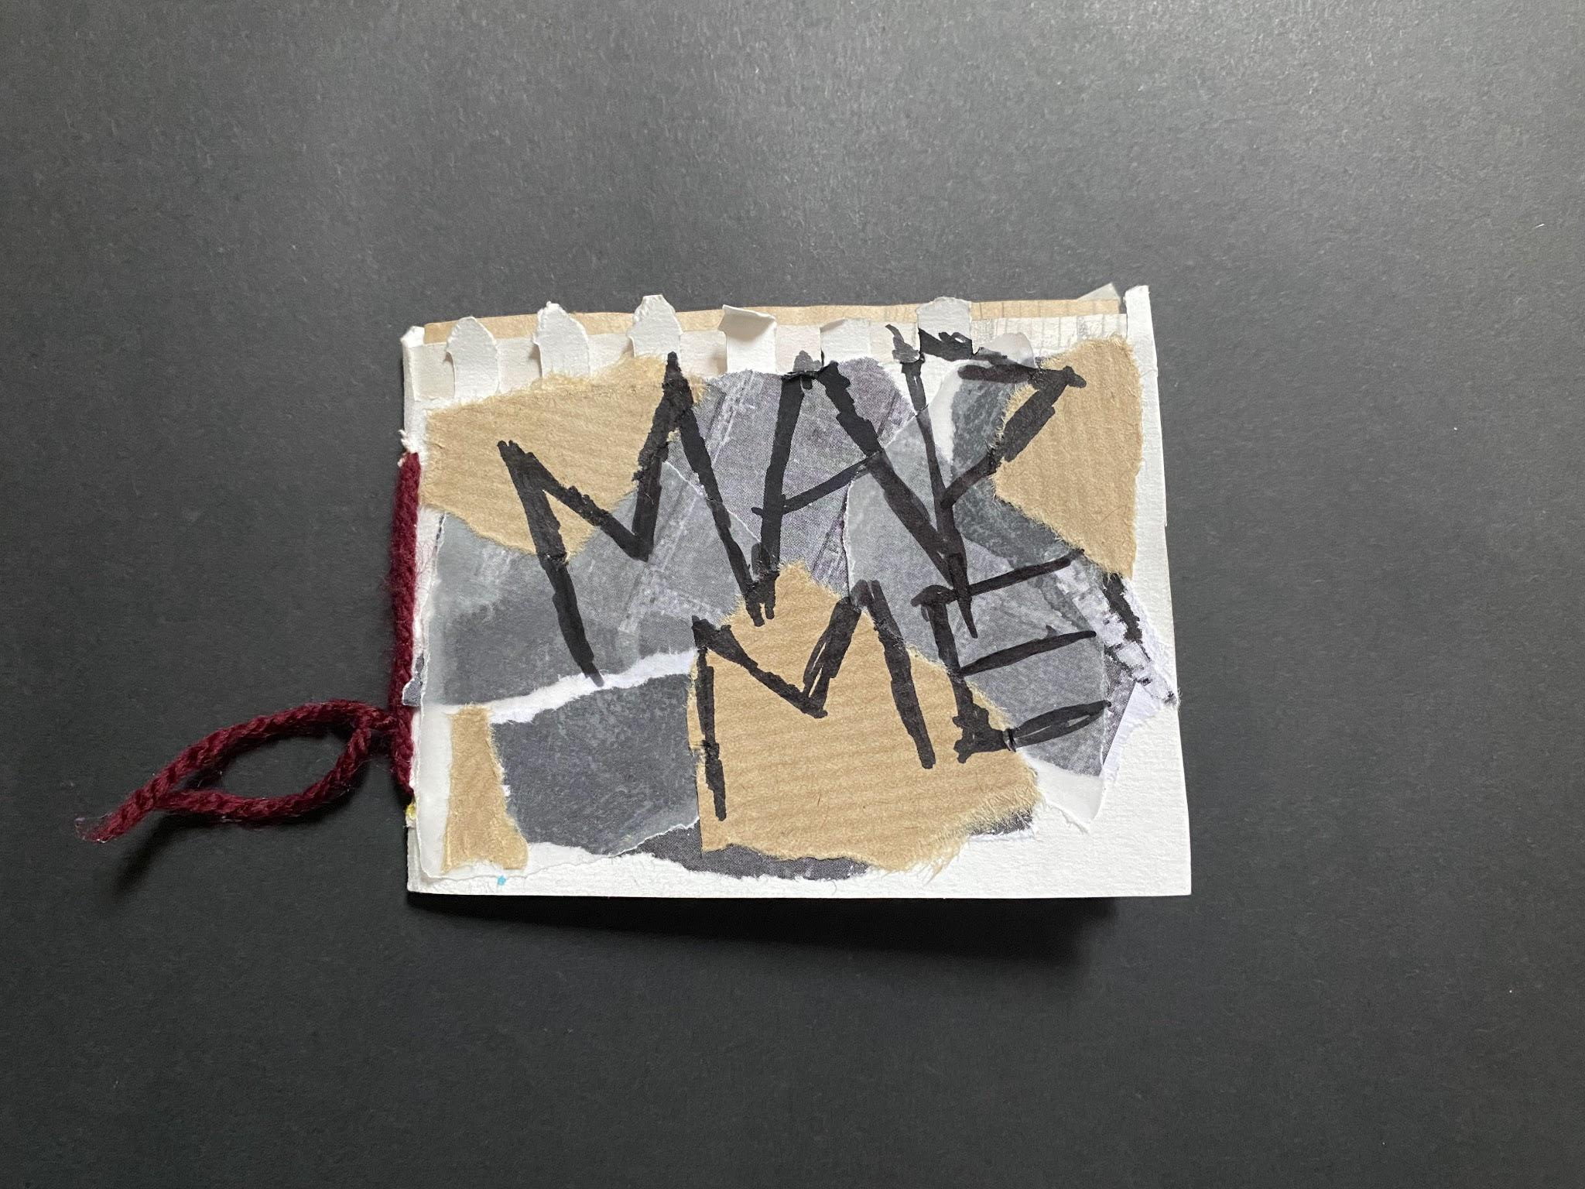
Some of Ms.Kirwan’s Collage work

Slide 6
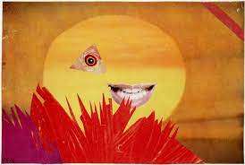
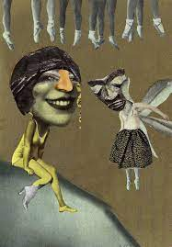
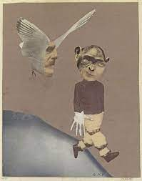
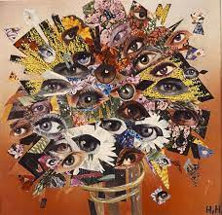
Artists that Use collage
Hannah Hoch
Do we like it or dislike ? and why

Slide 7
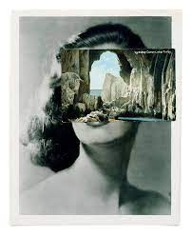
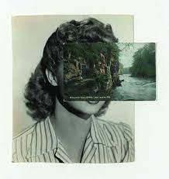
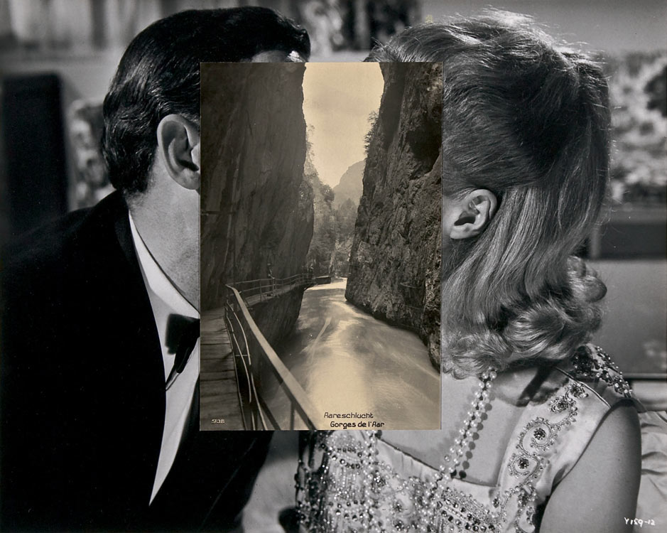
Artists that use Collage
John Stezaker
Do we like it or dislike ? and why

Slide 8
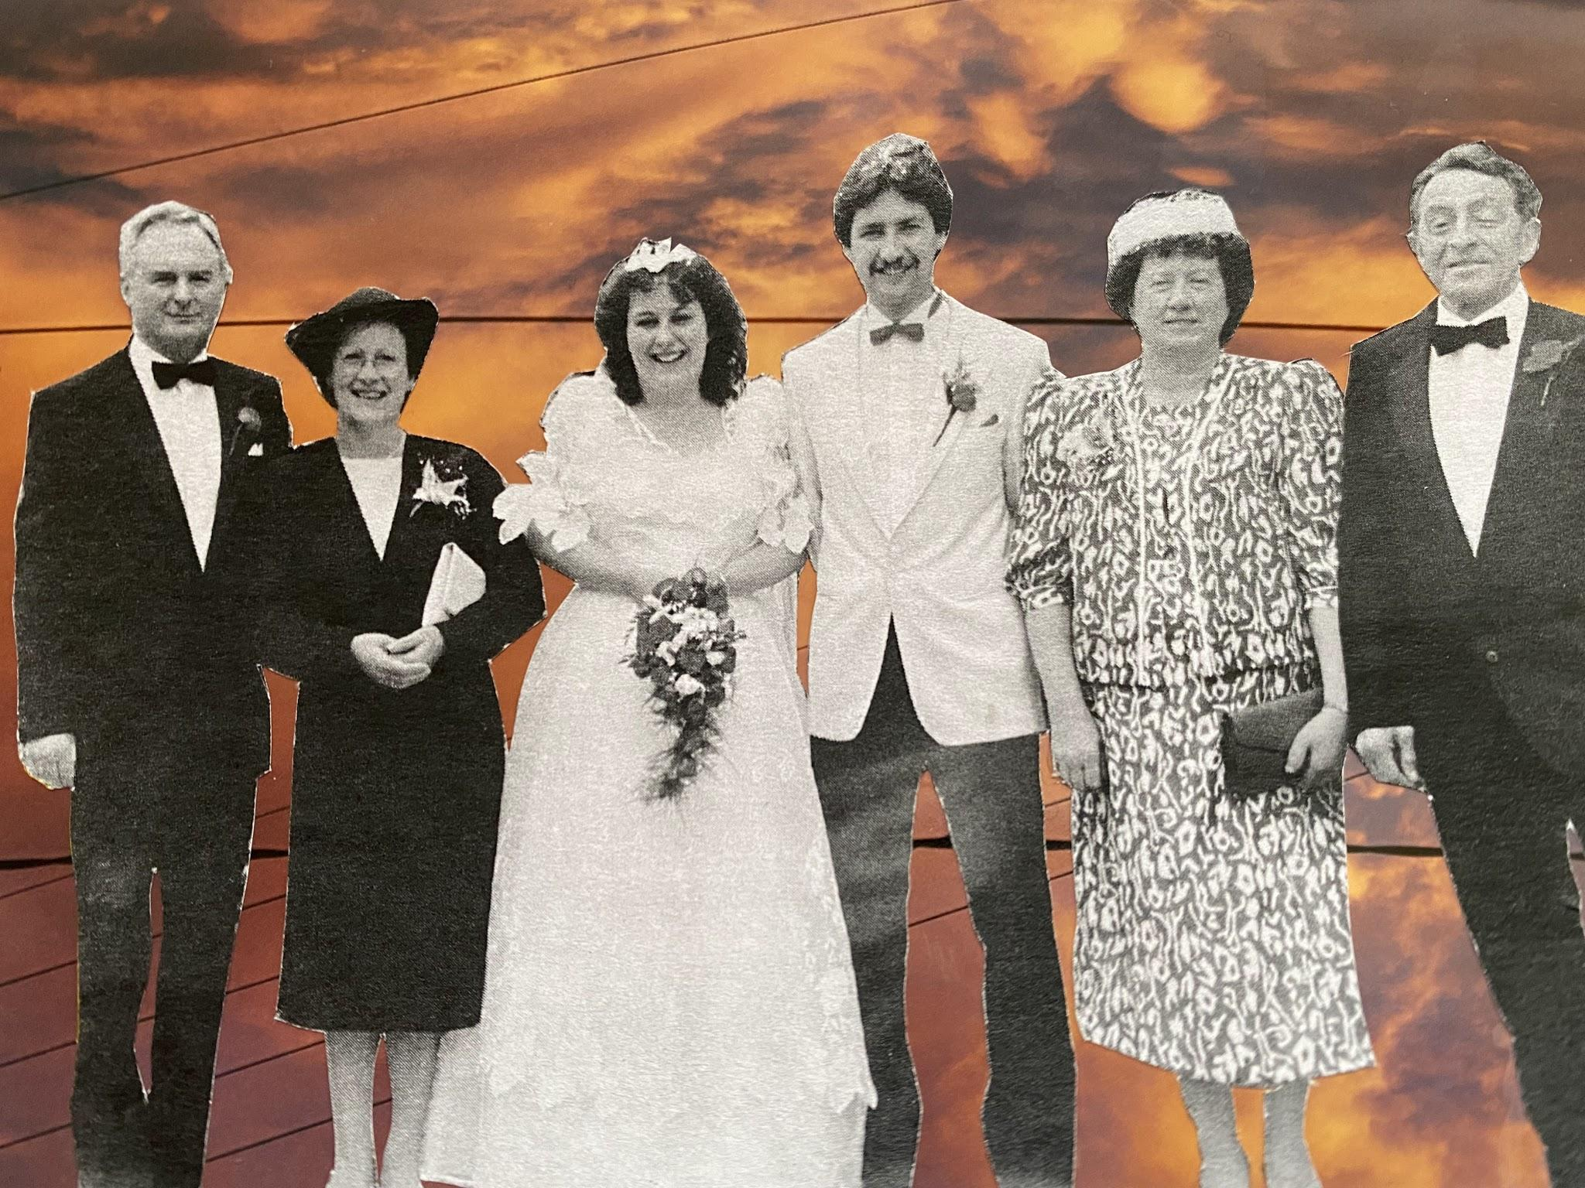
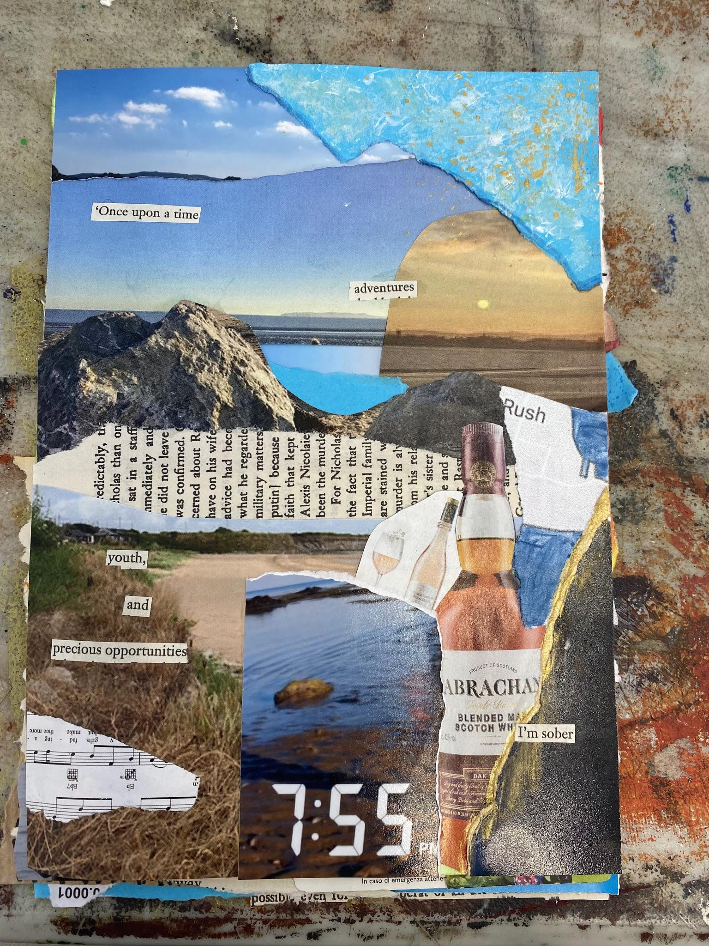
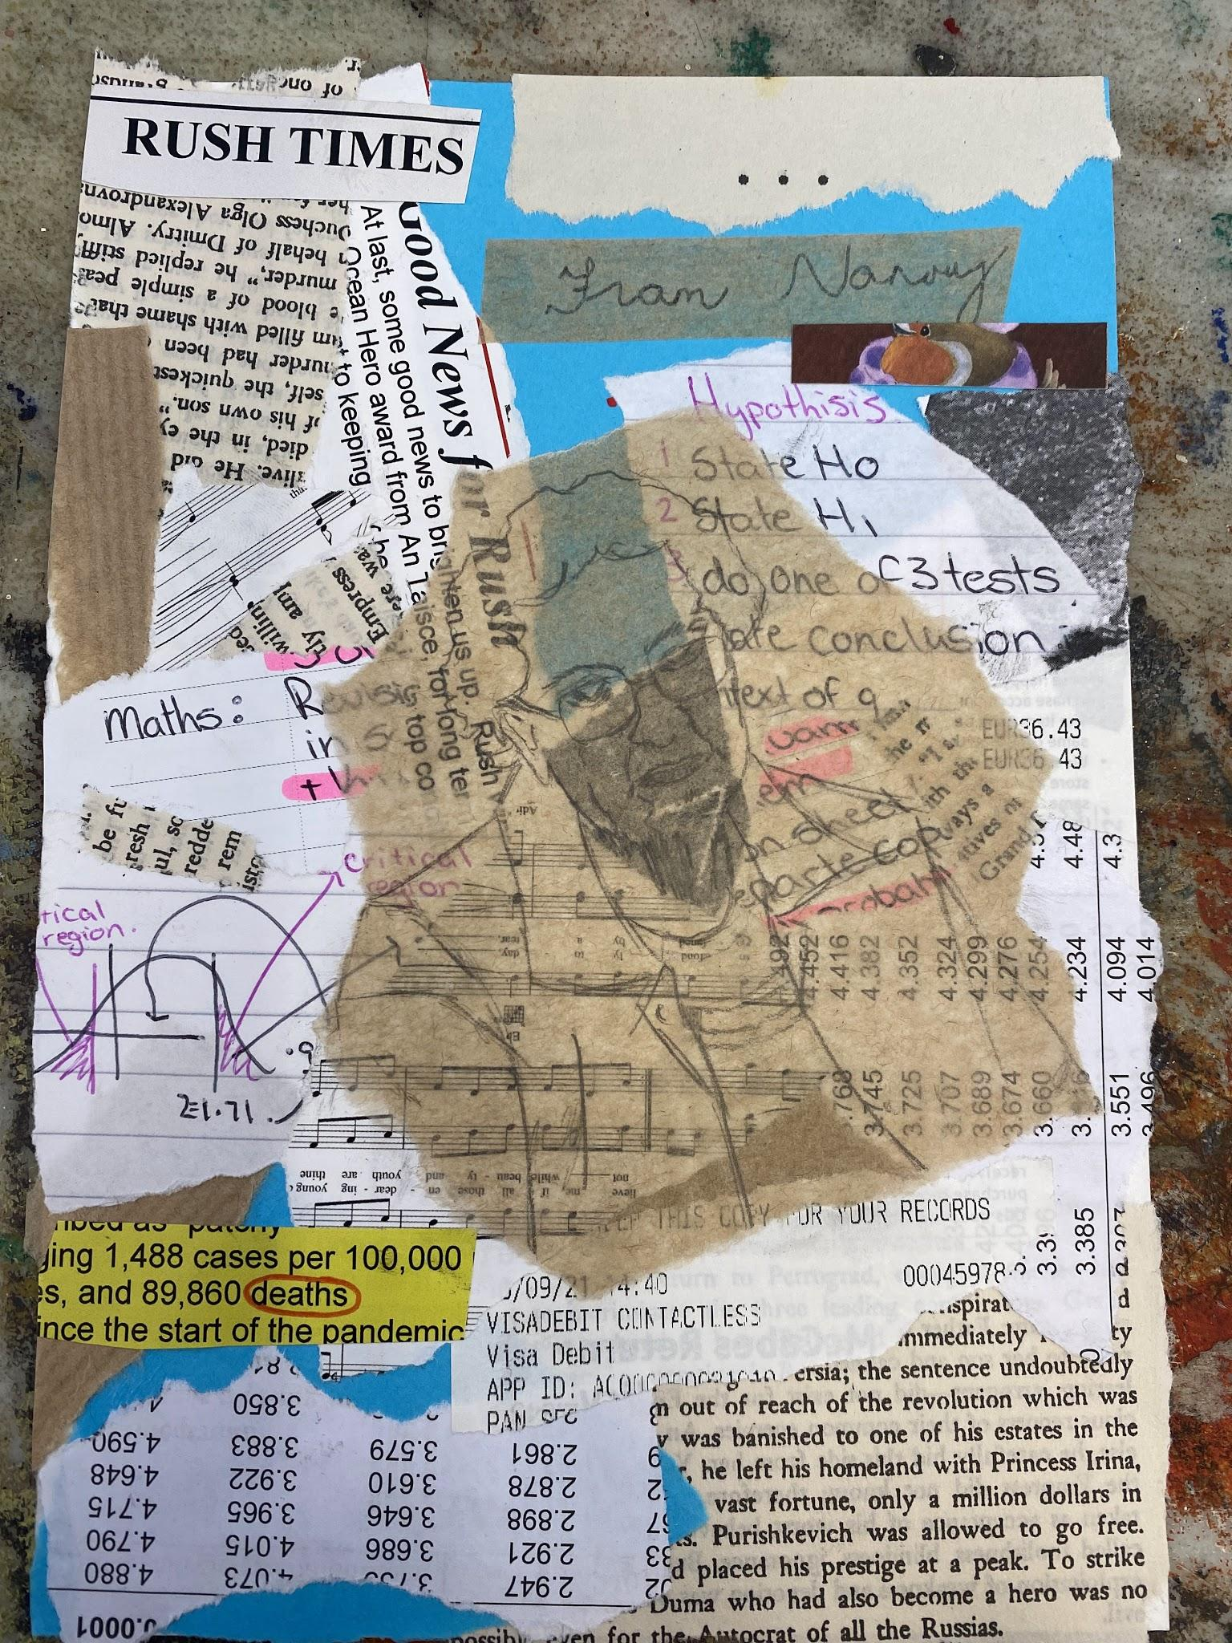
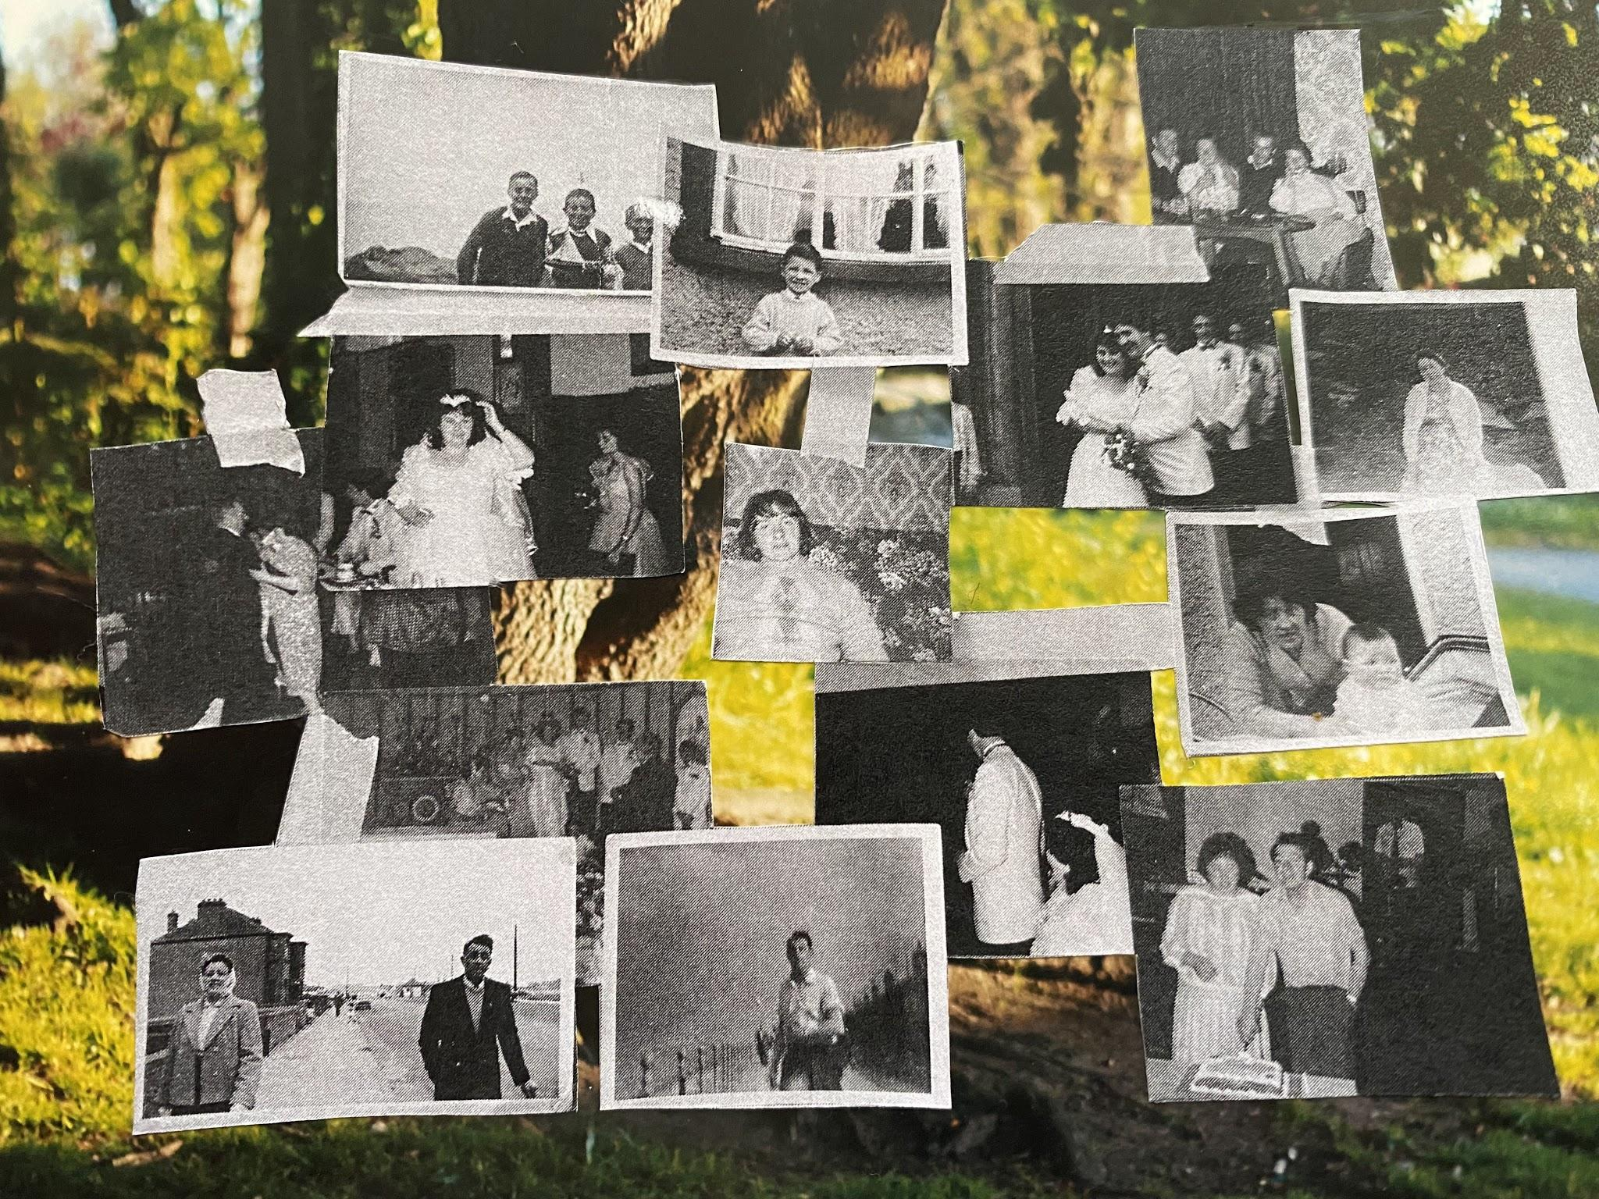
Today’s Tasks
Our paintings from the last week- I want to gather them up
I’m going to do a demonstration of how collage works
We are going to test out collage in our notebooks using pva and papers
On big sheets we are going to make a collage of famous dublin landmarks
At the end of the lesson we will talk about the work we made today and everyone can show their work

Slide 9
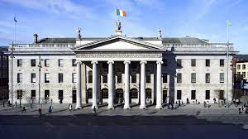
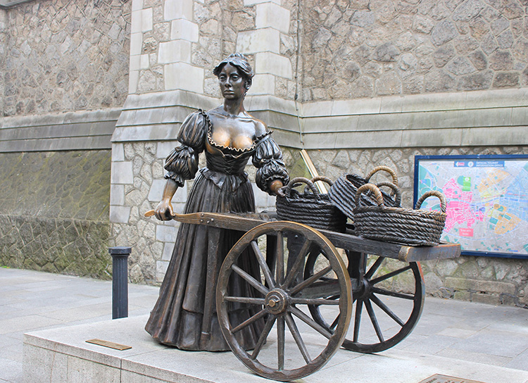
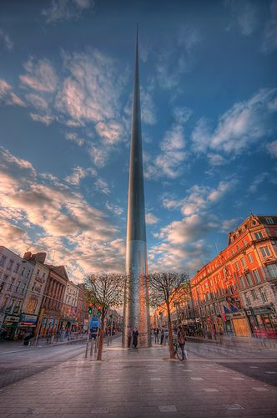
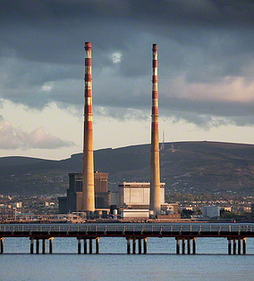
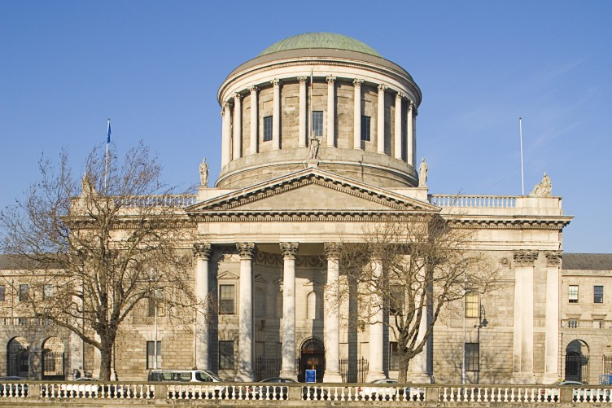
Landmarks in Dublin

