Slide 1
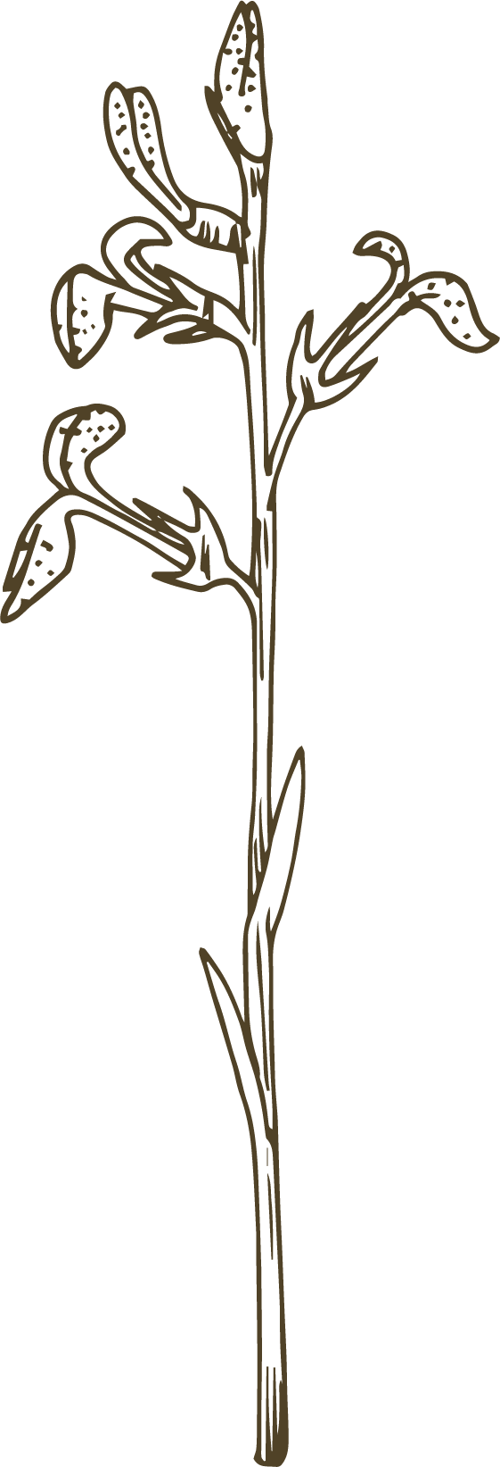
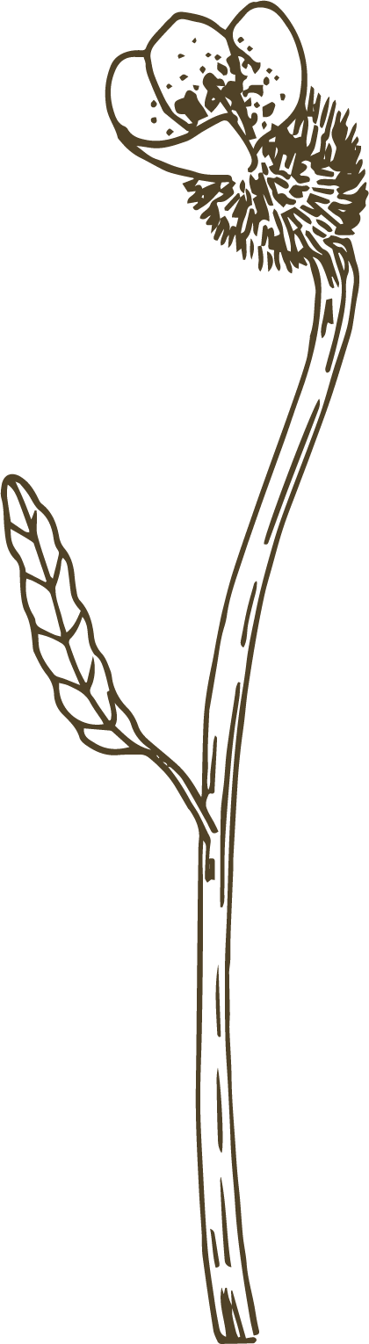
Fabric
&
Mapping
Fig. II
Fig. I
Venus
Ms.Kirwan

Slide 2
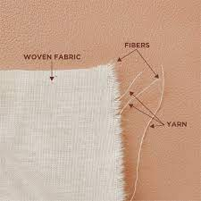
Fabric
What is Fabric ?
Fabric is a material that is made by weaving or knitting fibers
Can someone show me an example of fabric in the classroom?

Slide 3
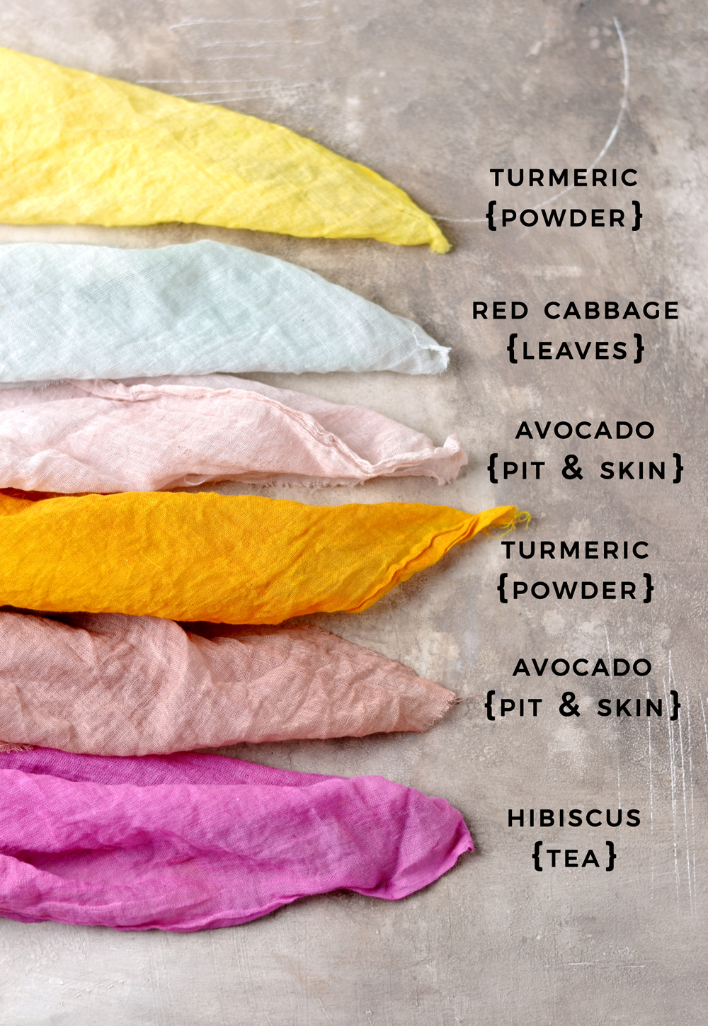
Natural Dyes
What are Natural Dyes?
Natural Dyes are dyes or colours made from things that grow, such as vegetables, plants, spices etc

Slide 4
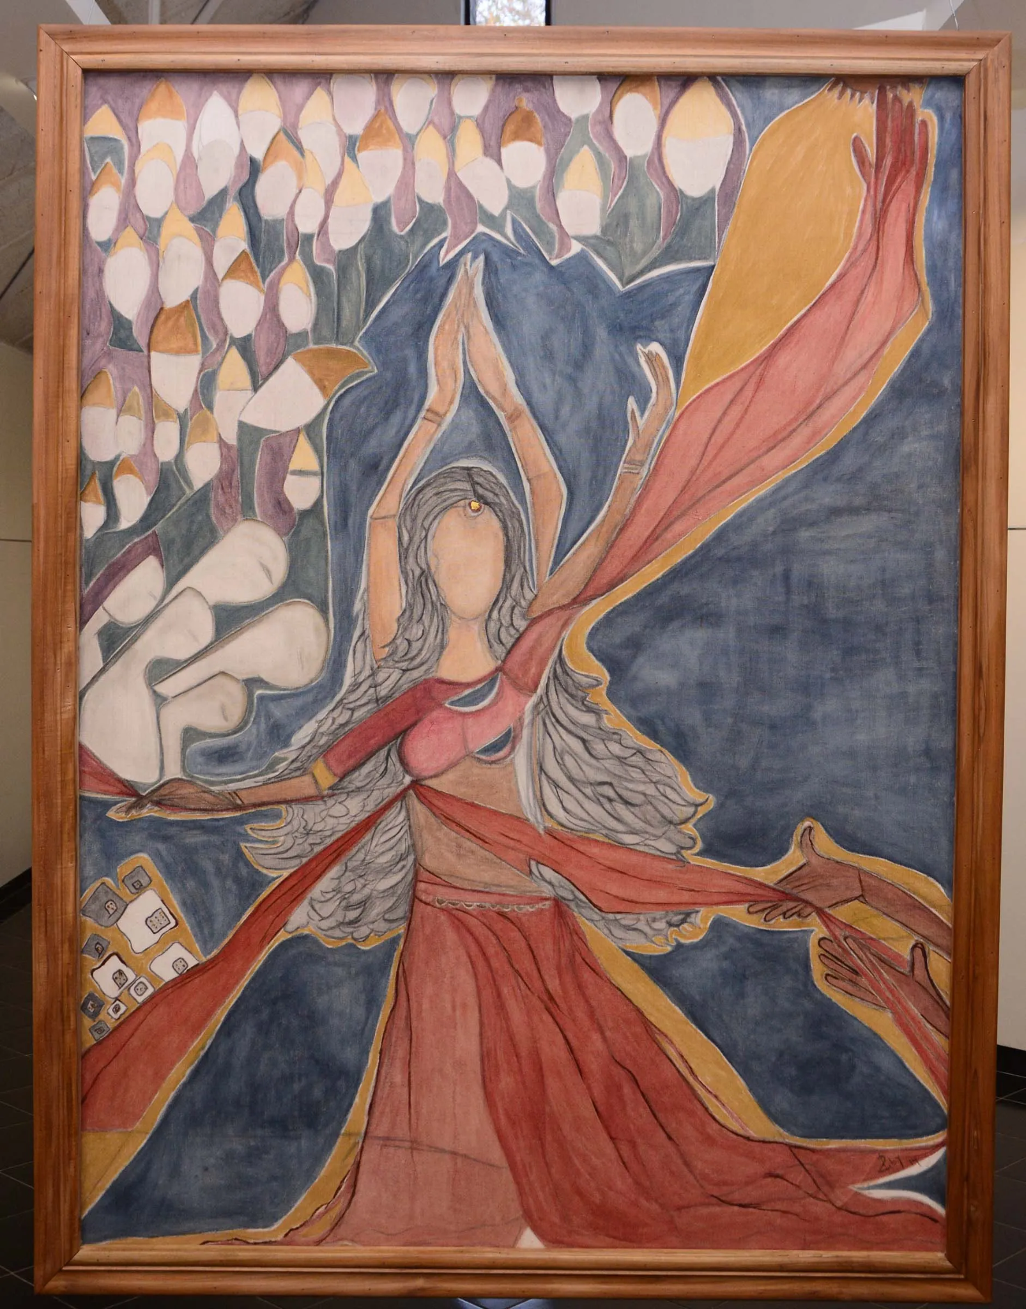
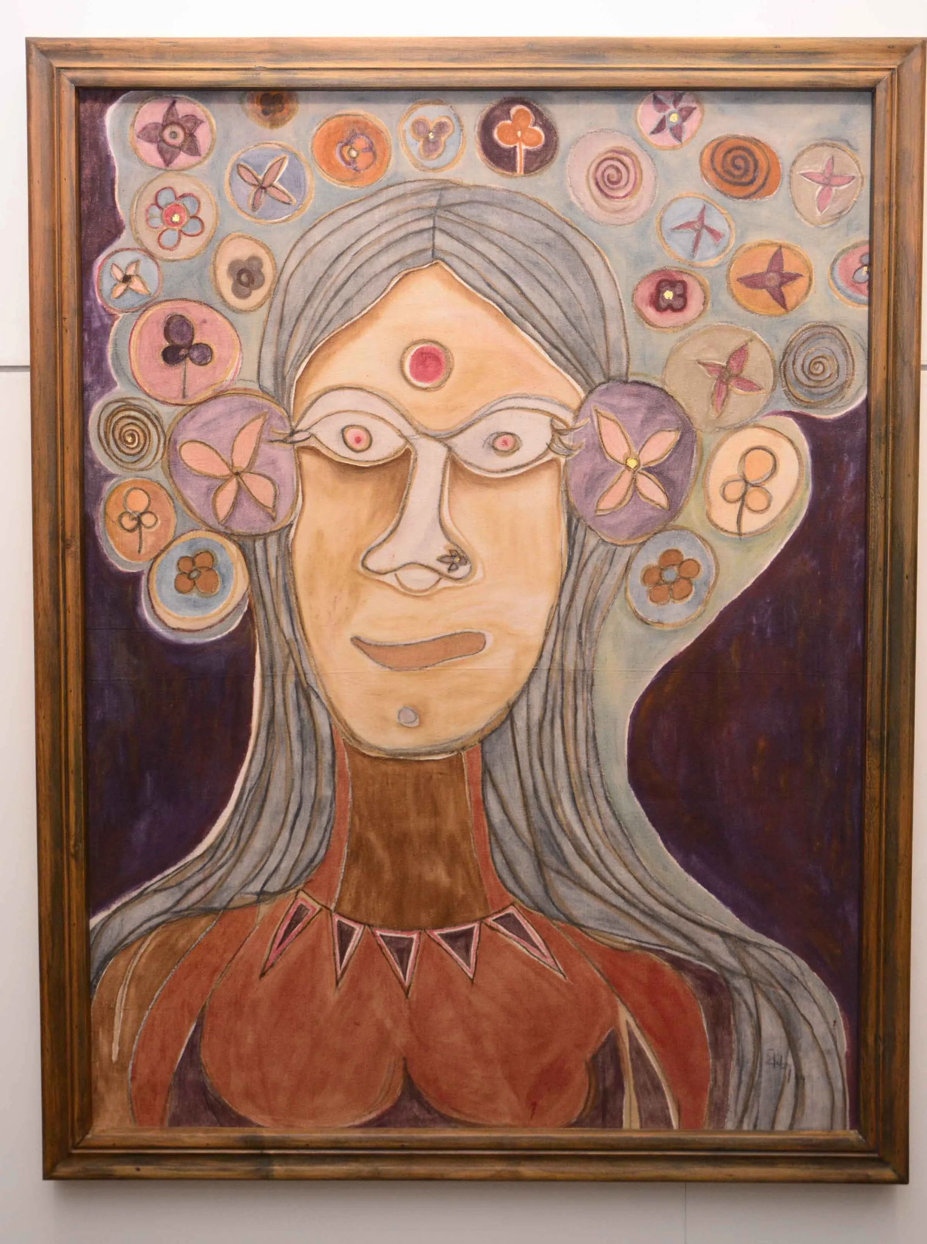
Artists use fabric
Ruby Jagrut

Slide 5
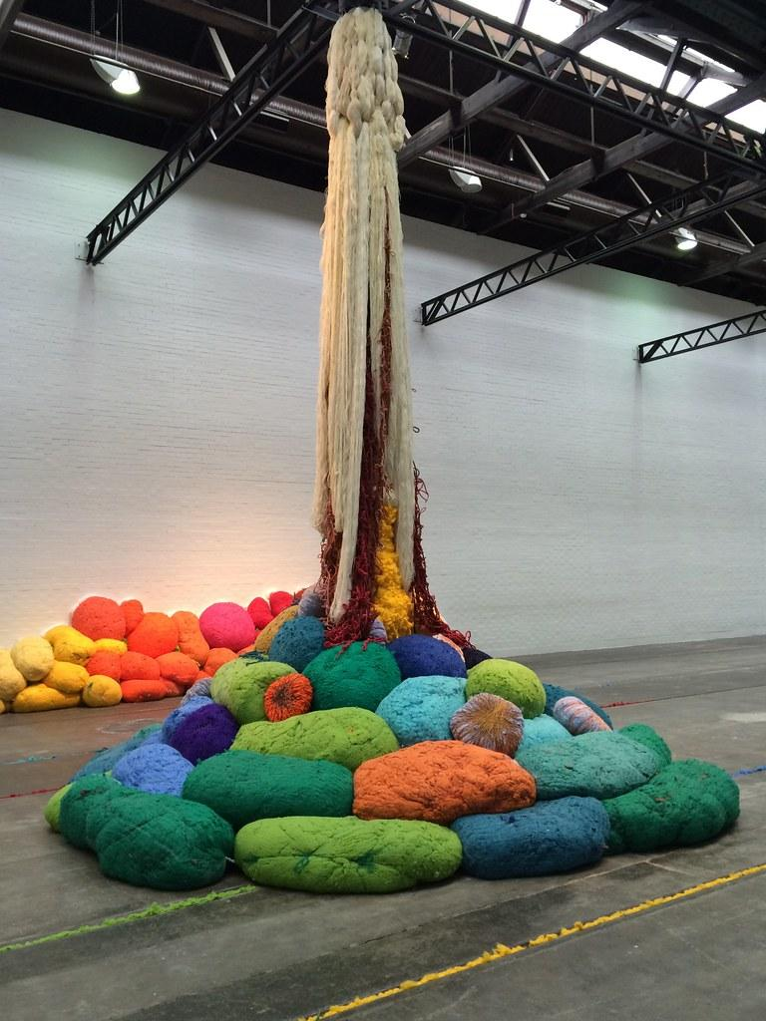
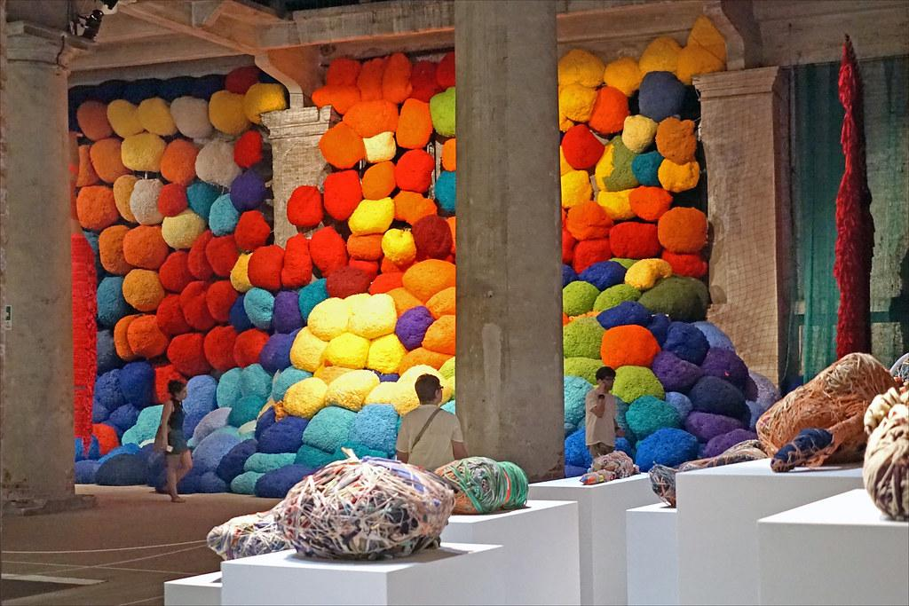
Artists use fabric
Sheila Hicks

Slide 6
Today's Tasks
We are going to have a look at the natural dyes - can we guess what they are made from ?
We are going to test all the colours on a piece of fabric -Ms.Kirwan will staple it into your notebook after
On big pieces of fabric we are going to draw things we see on the way to school using the natural dyes
IF WE HAVE TIME:
We will talk about our work
Add some colour to your notebooks
Talk about next week's class

Slide 7

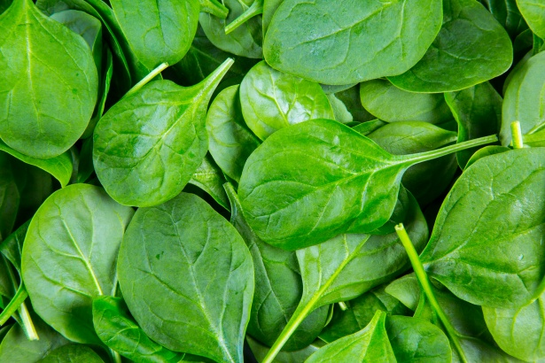
Green

Slide 8

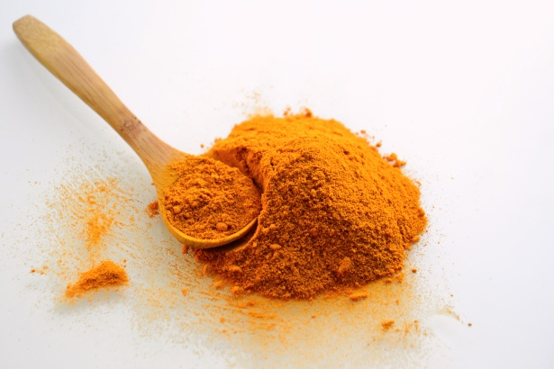
Yellow

Slide 9

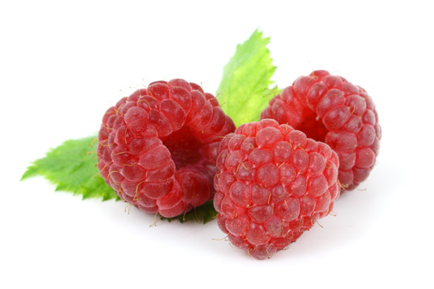
Pink

Slide 10

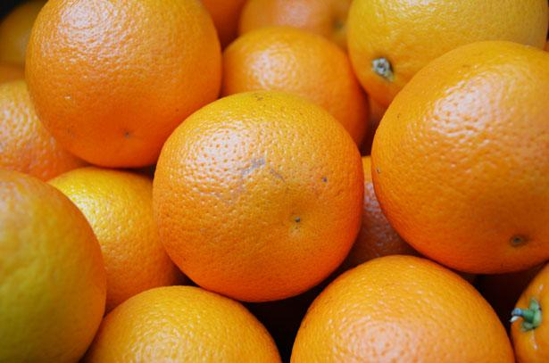
Orange

Slide 11

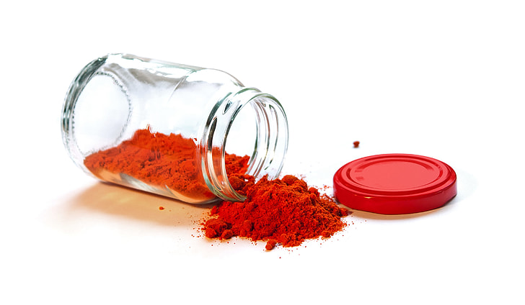
Red

Slide 12
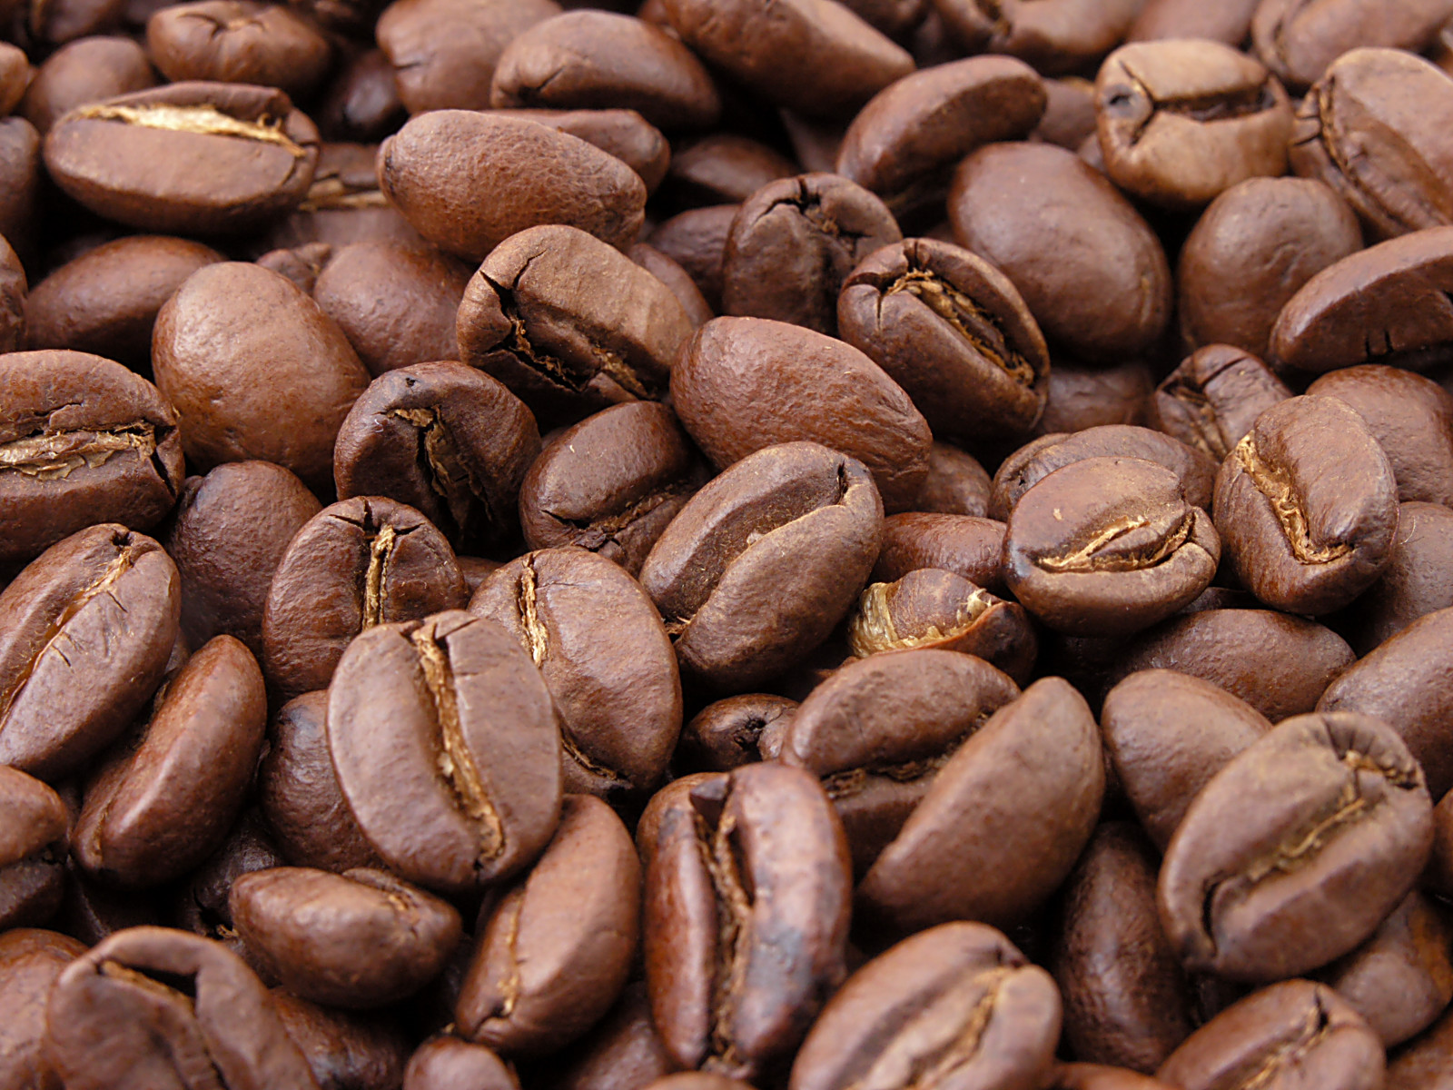

Brown

