Slide 1
Lesson 4: Printing
Ms.Kirwan

Slide 2
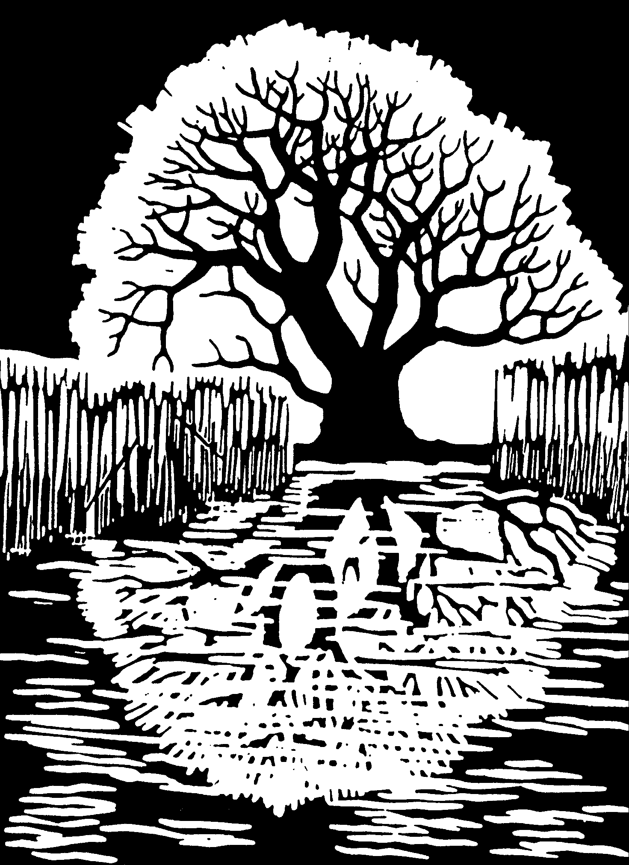
What is Printing ?
Printmaking means producing images or text usually on paper but occasionally on fabric, parchment, plastic.

Slide 3
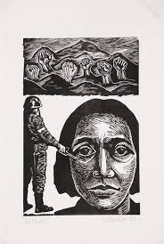
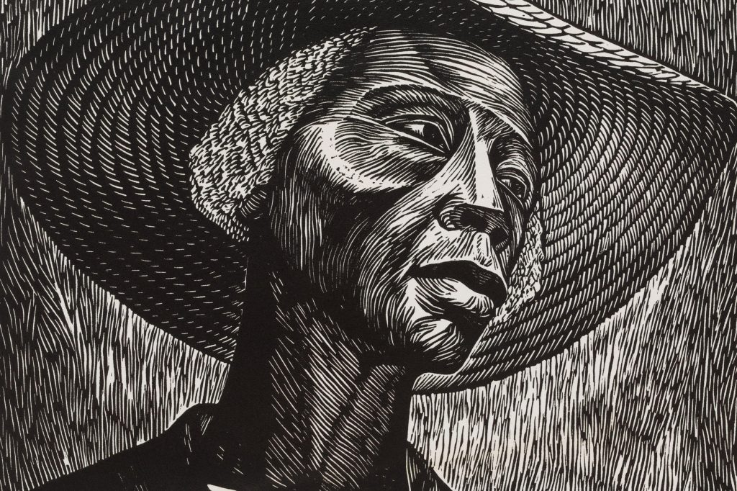
Artists that Use Print
Elizabeth Catlett- Lino

Slide 4
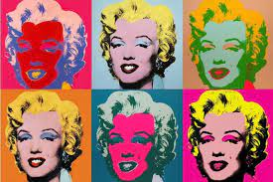
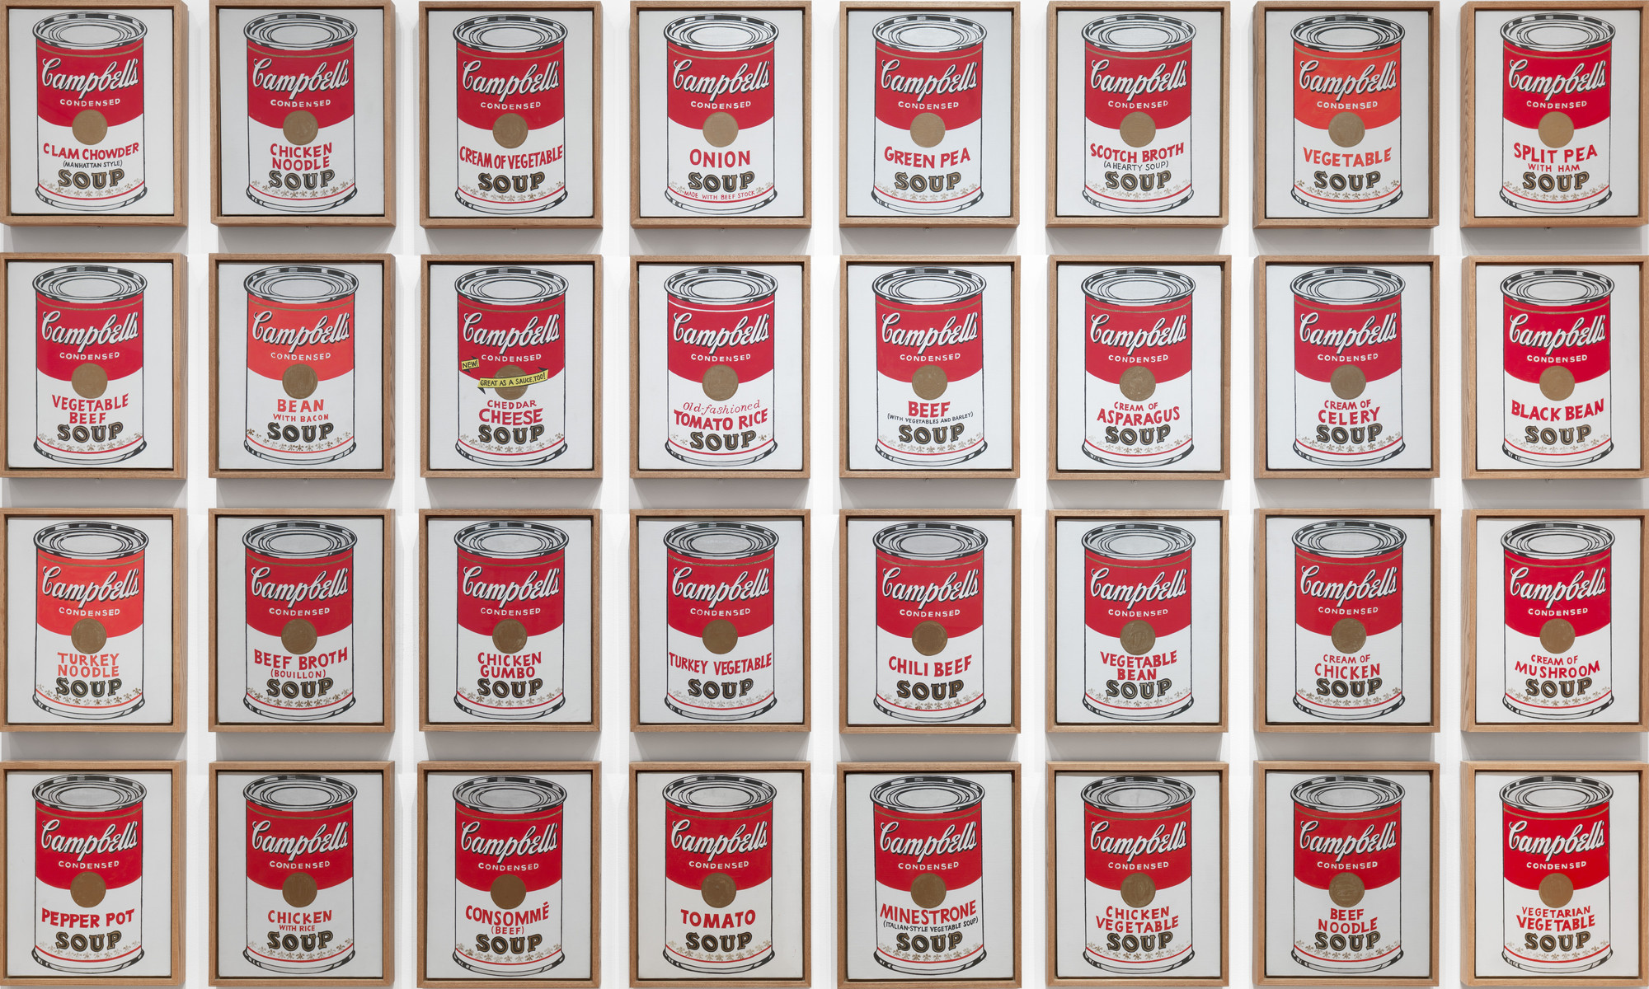
Artists that Use Print
Andy Warhol - Screen Print

Slide 5
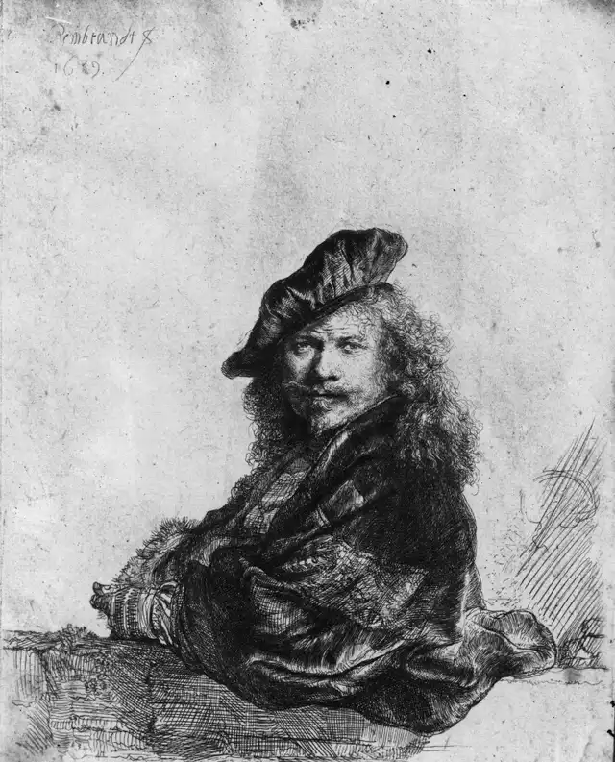
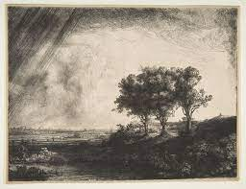
Artists that use Print
Rembrandt- Etching

Slide 6
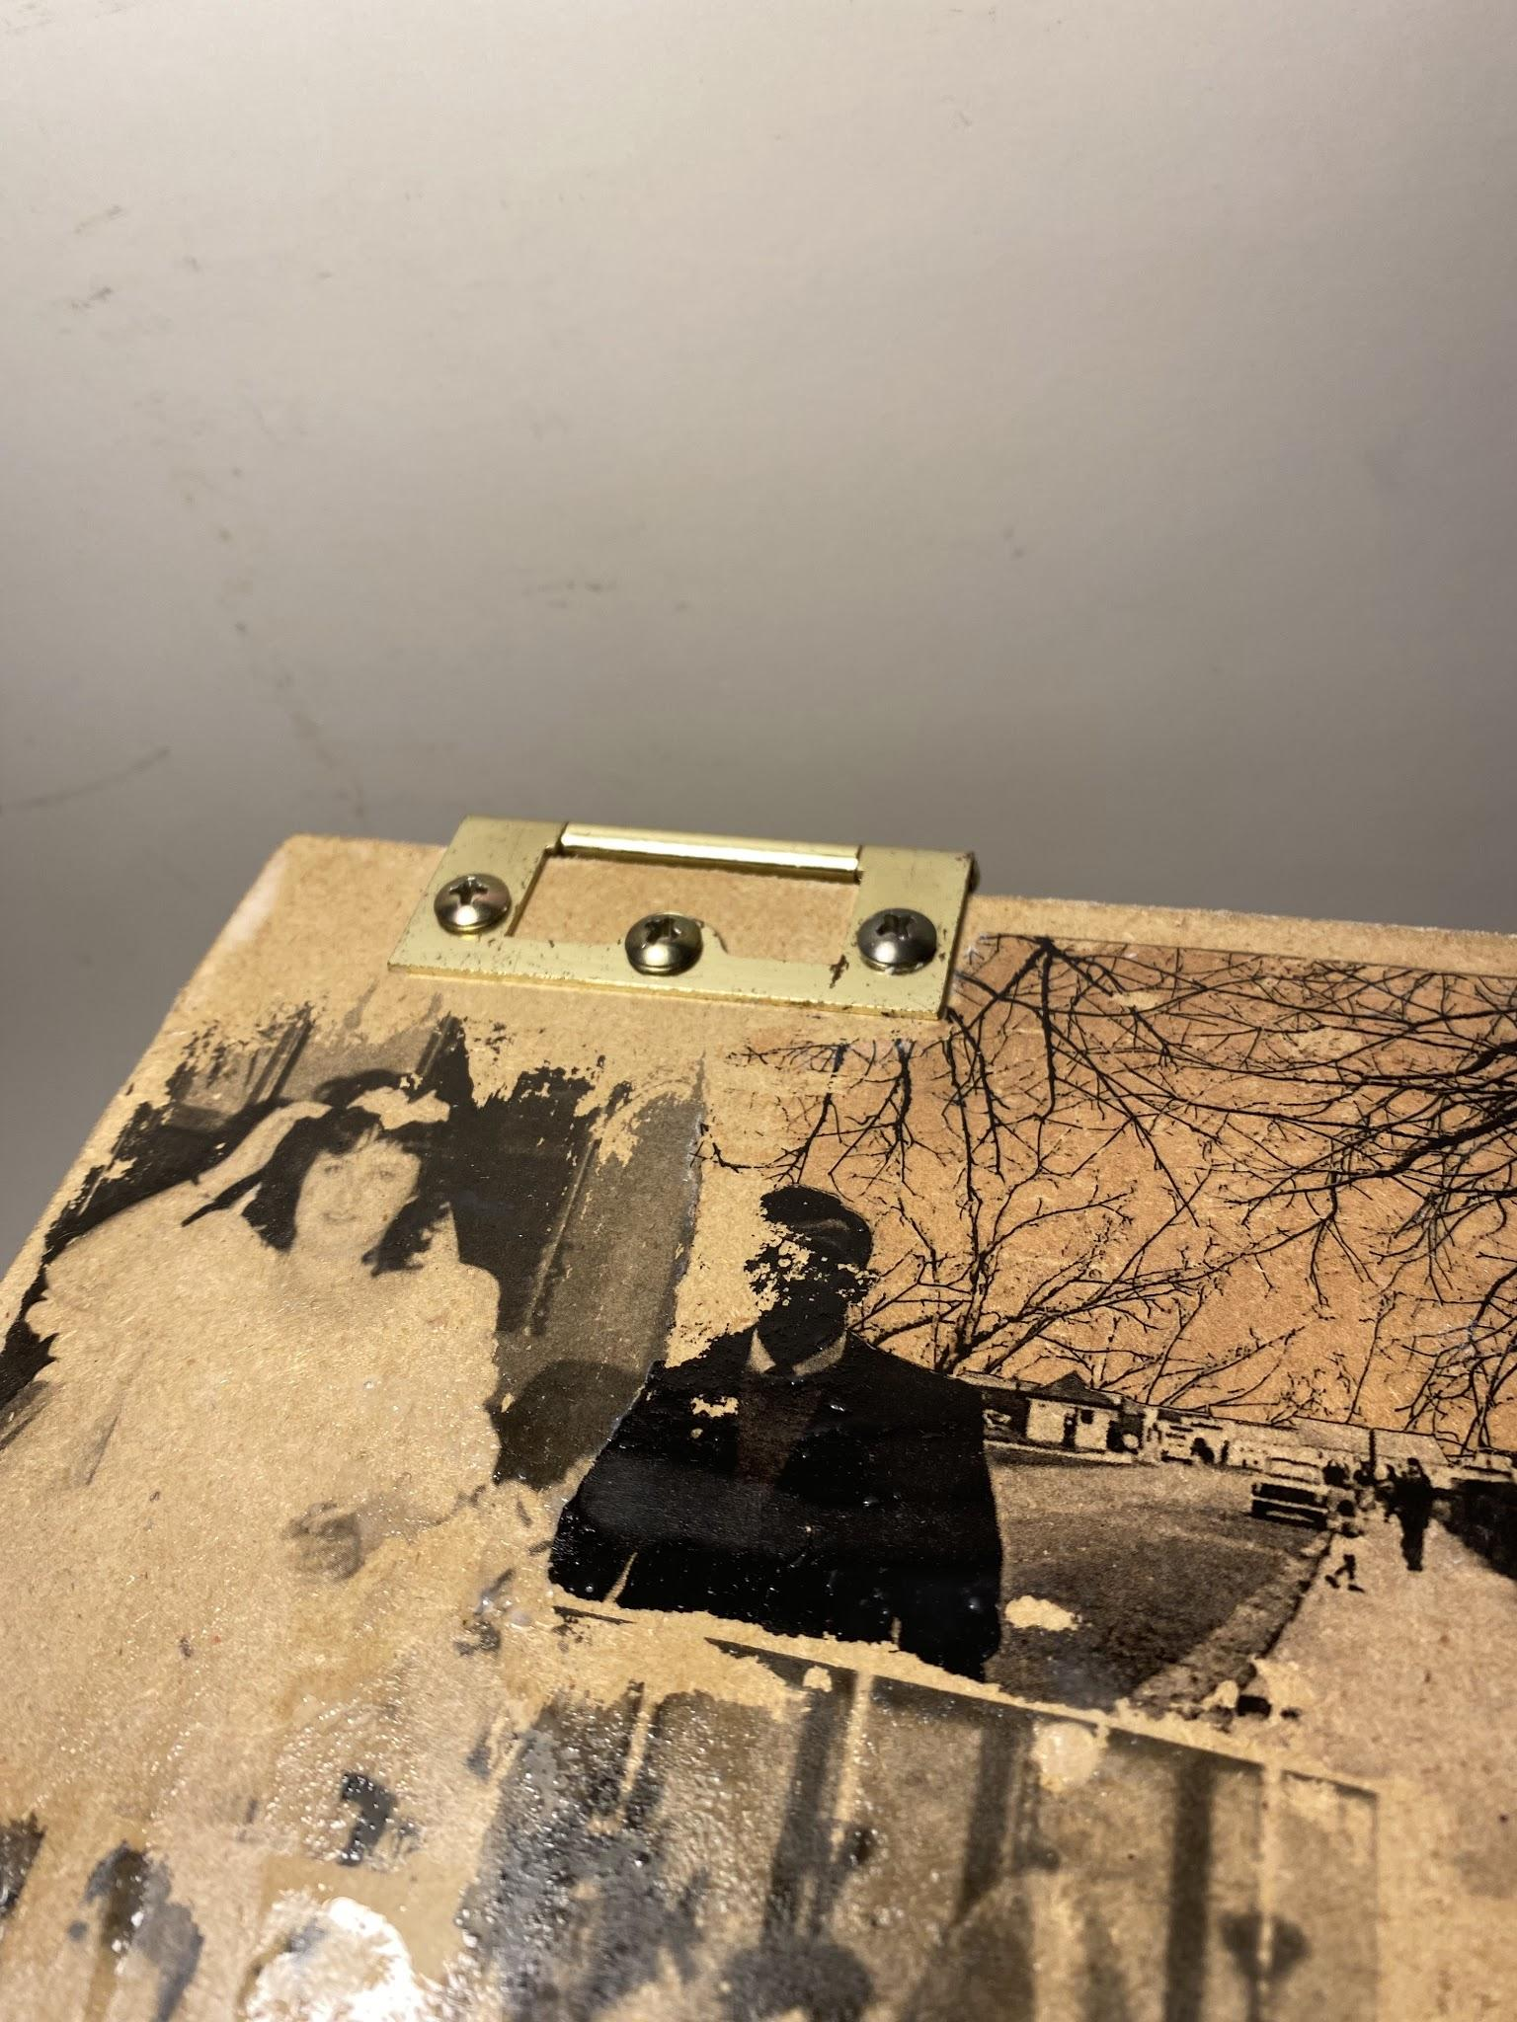
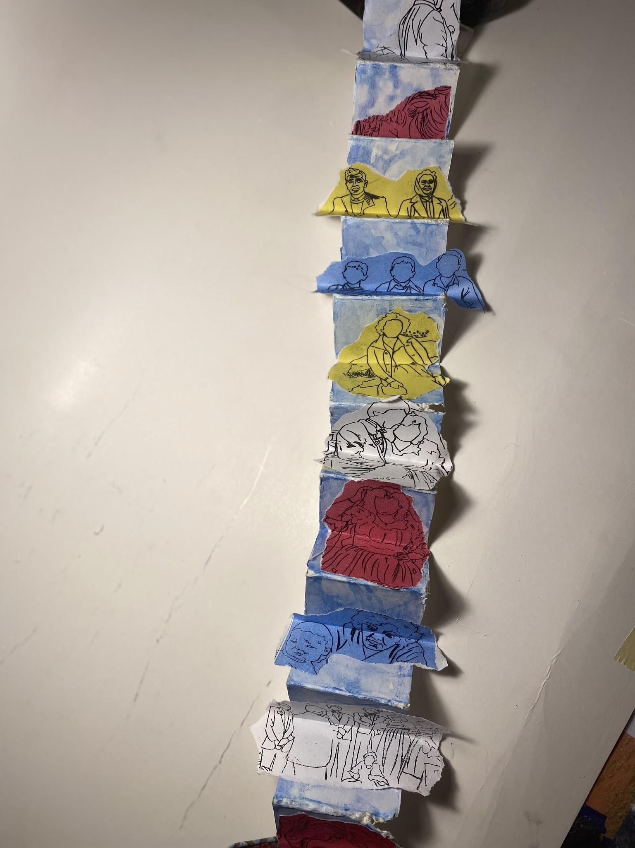
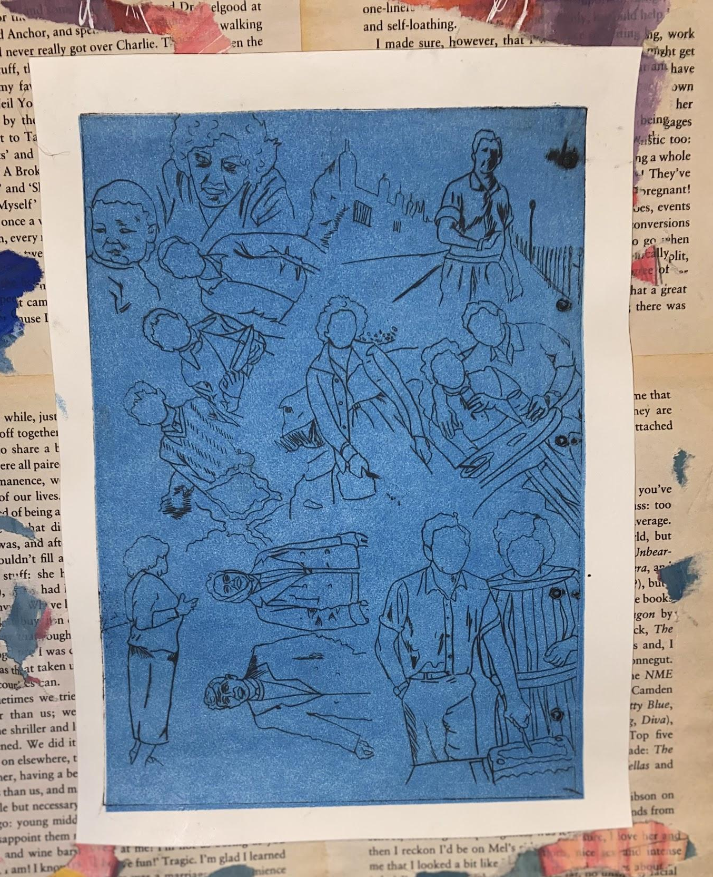
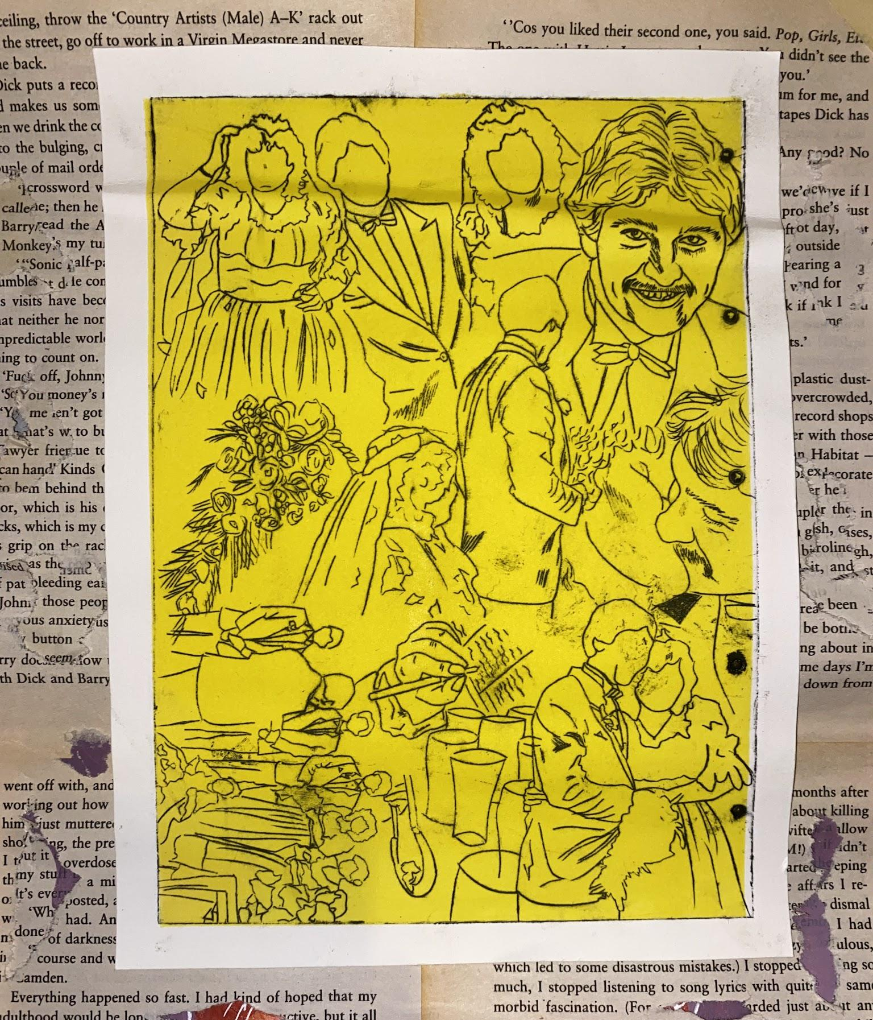
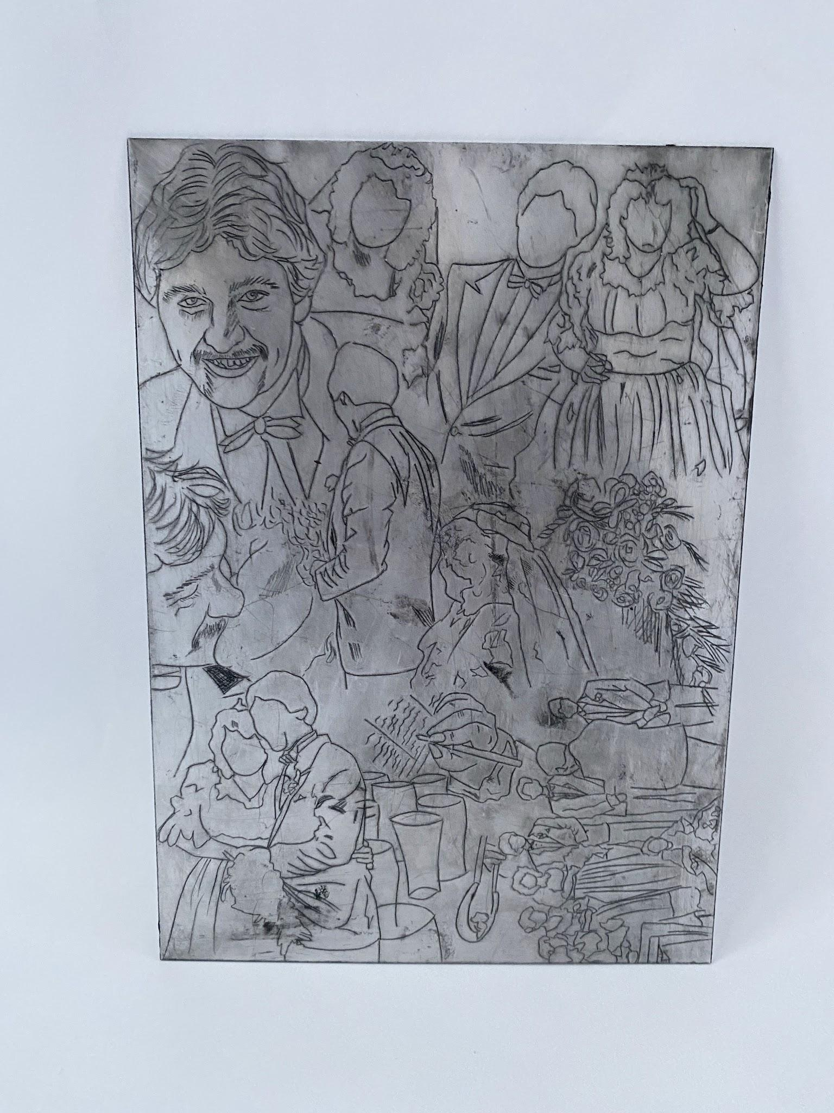
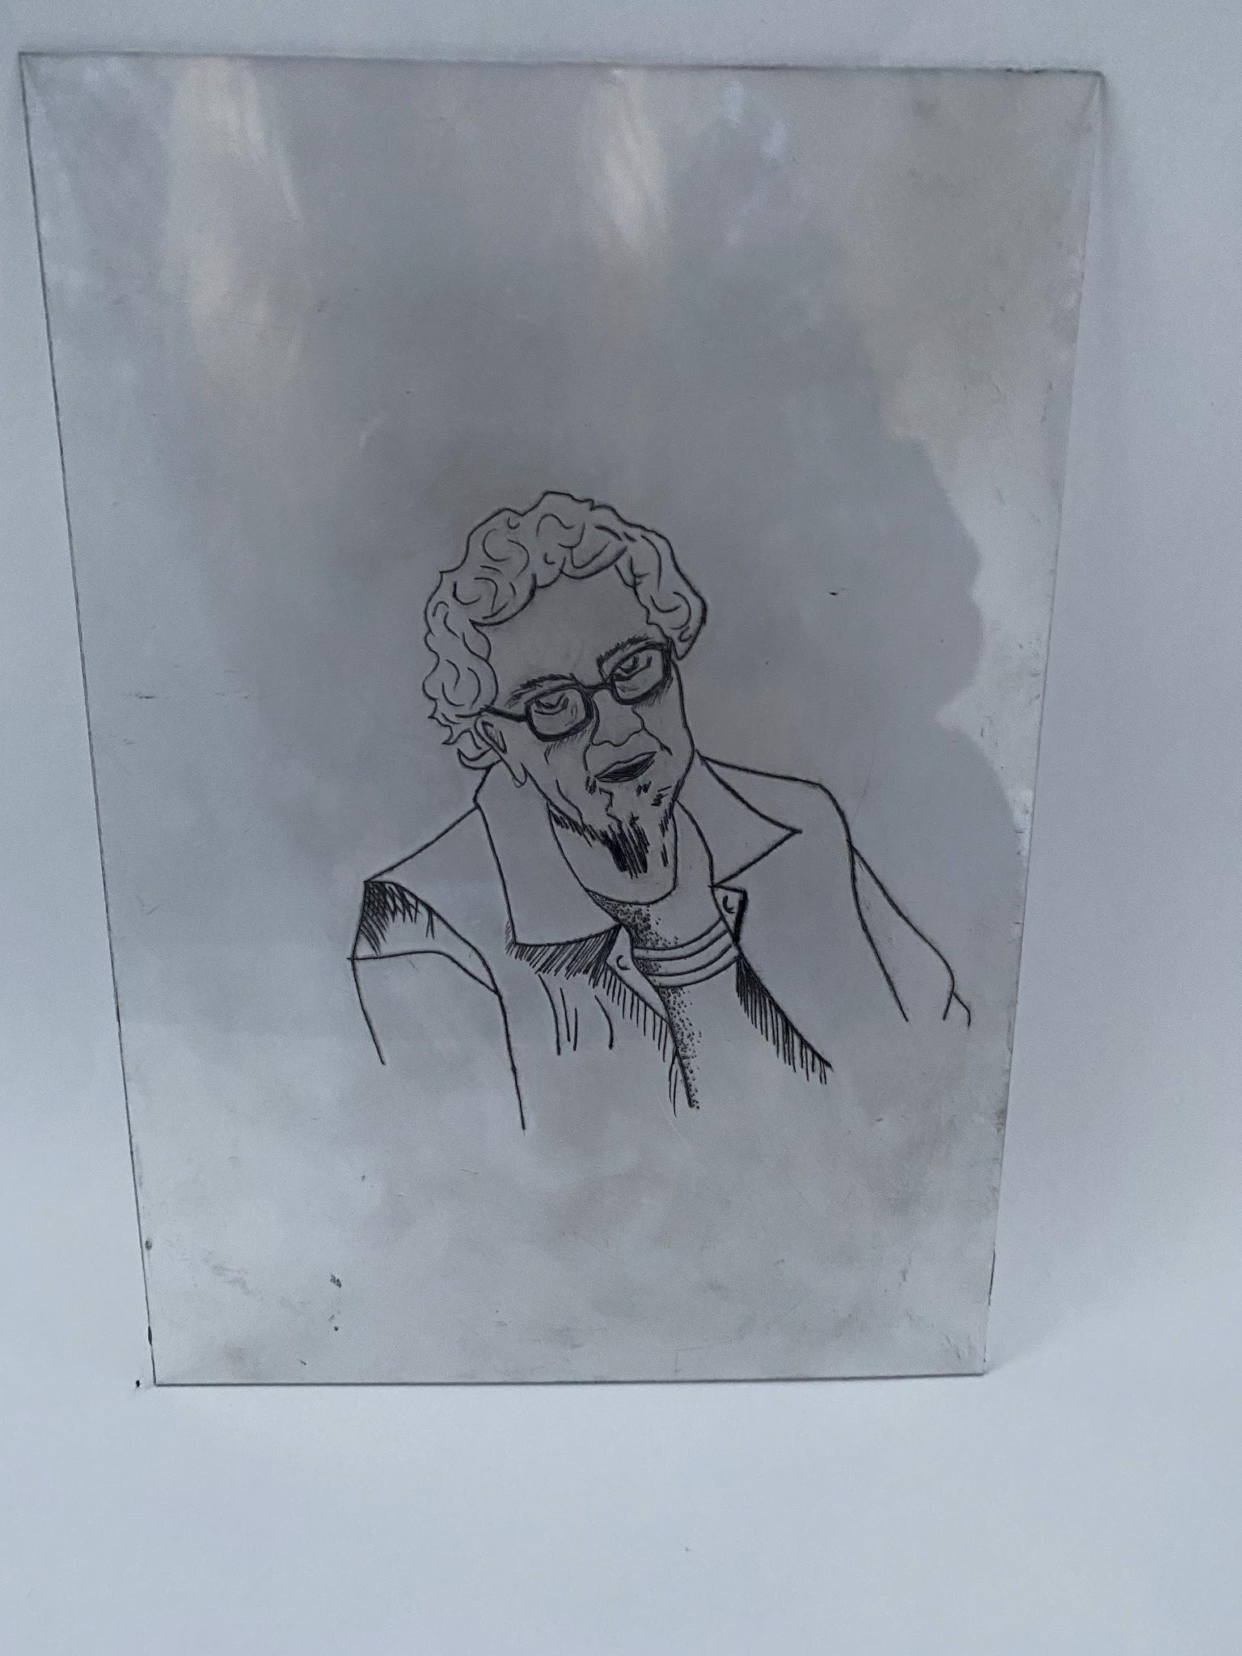
Ms.Kirwan’s Prints

Slide 7
Tasks for Today
We are going to create foam prints -drawing things we see on the way to school everyday
Ms. Kirwan is going to do a demonstration- then it will be your turn
We/ Ms.Kirwan will put our foam plates into our notebooks
LAST WEEK: EXHIBITION WEEK

