Slide 1
Lesson 1:
Mapping
Ms.Kirwan

Slide 2
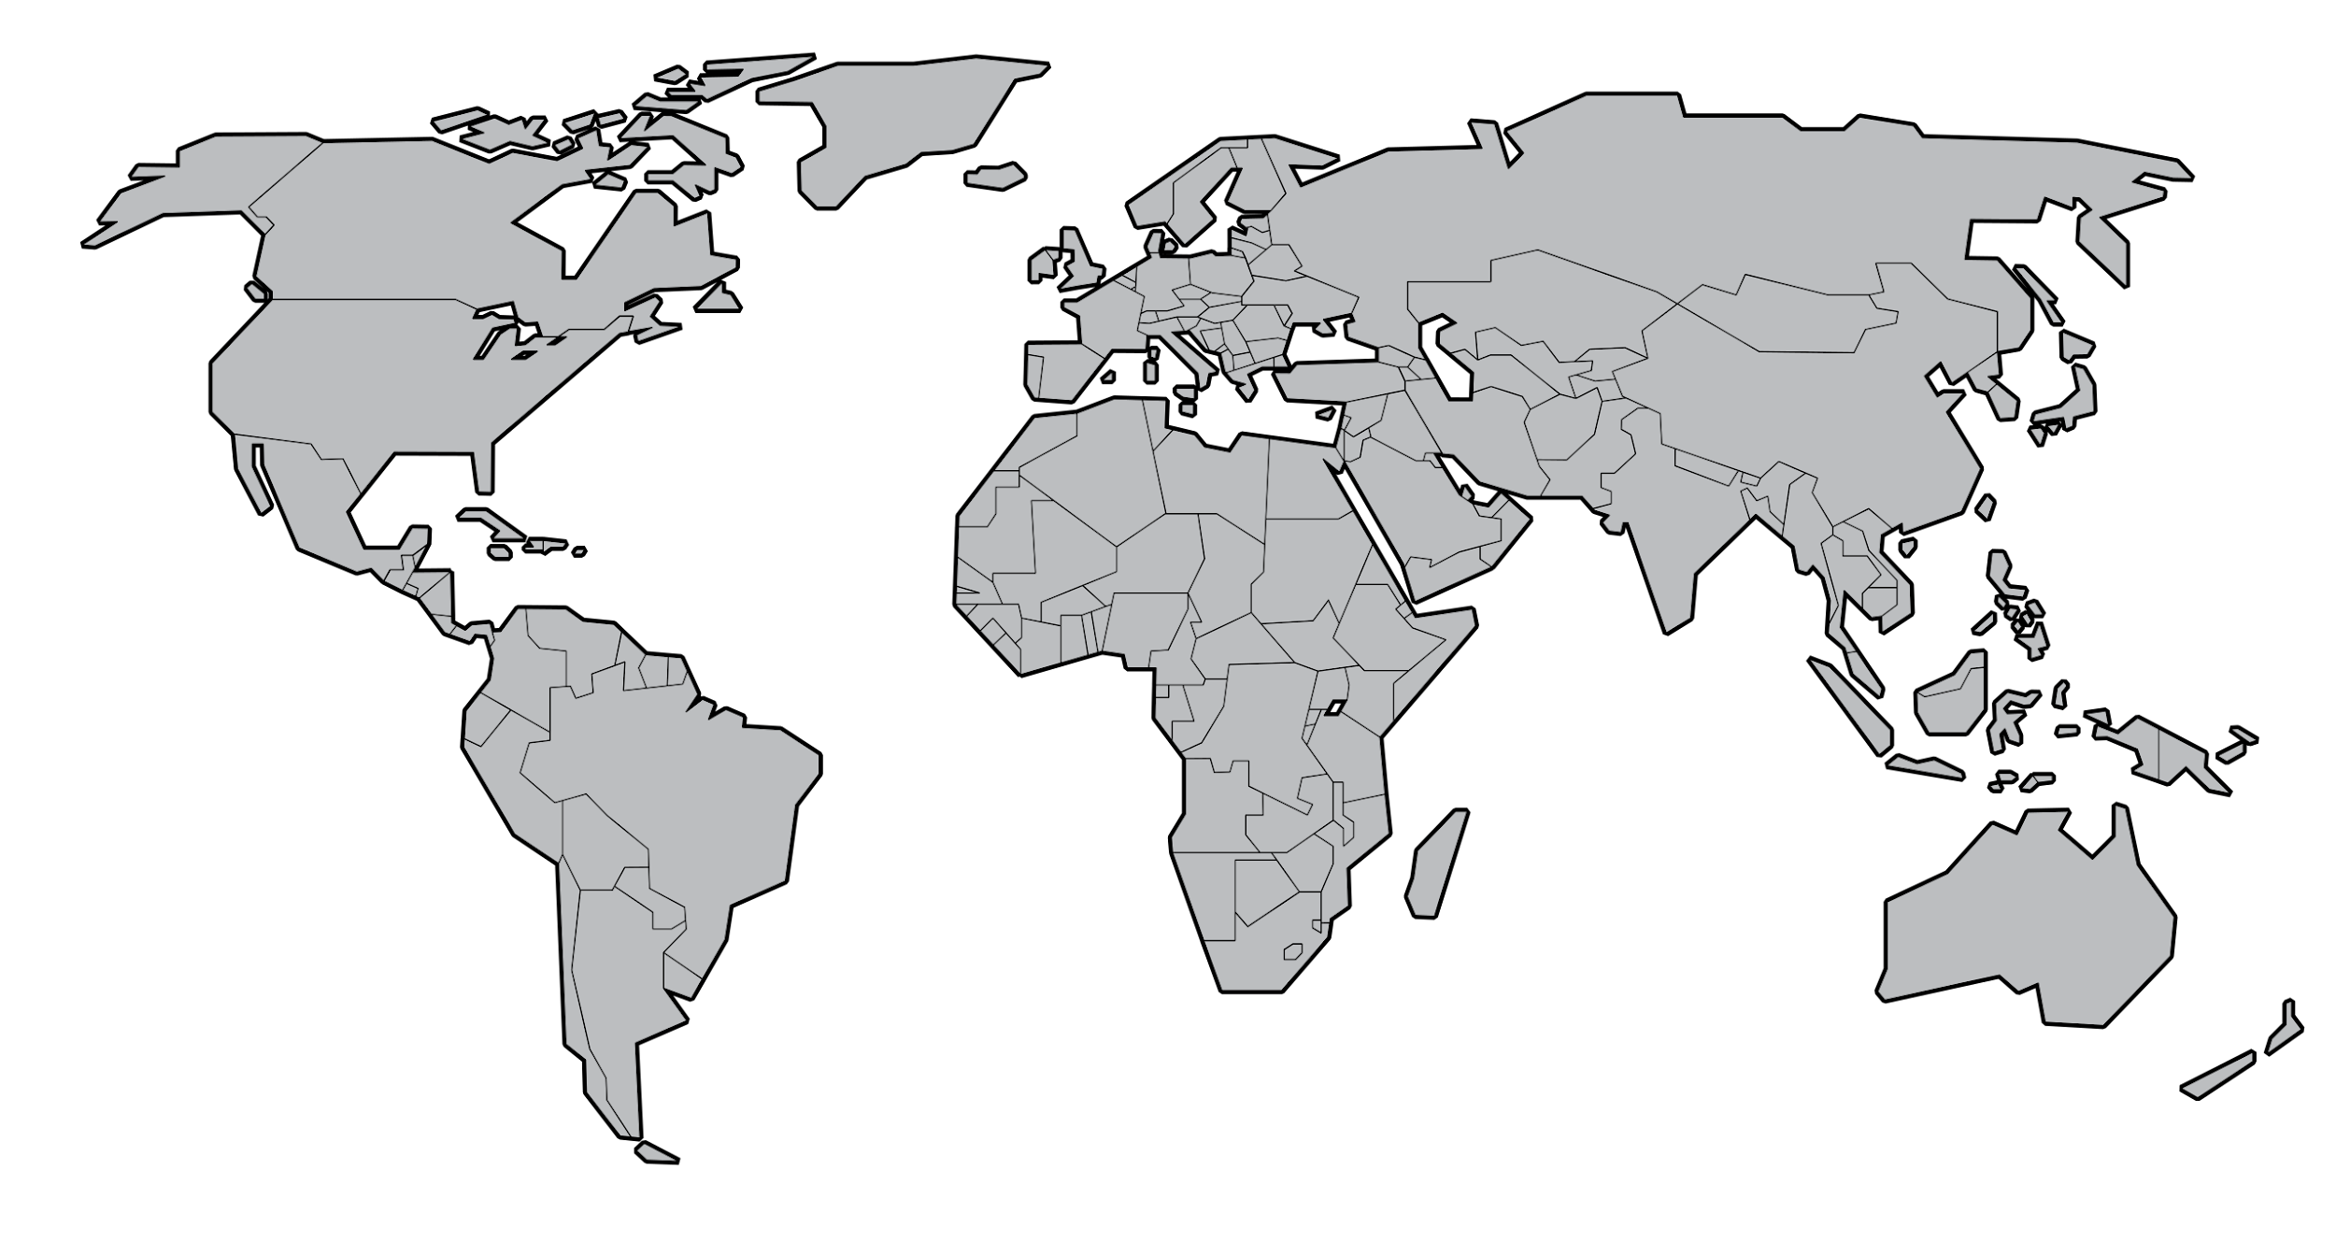
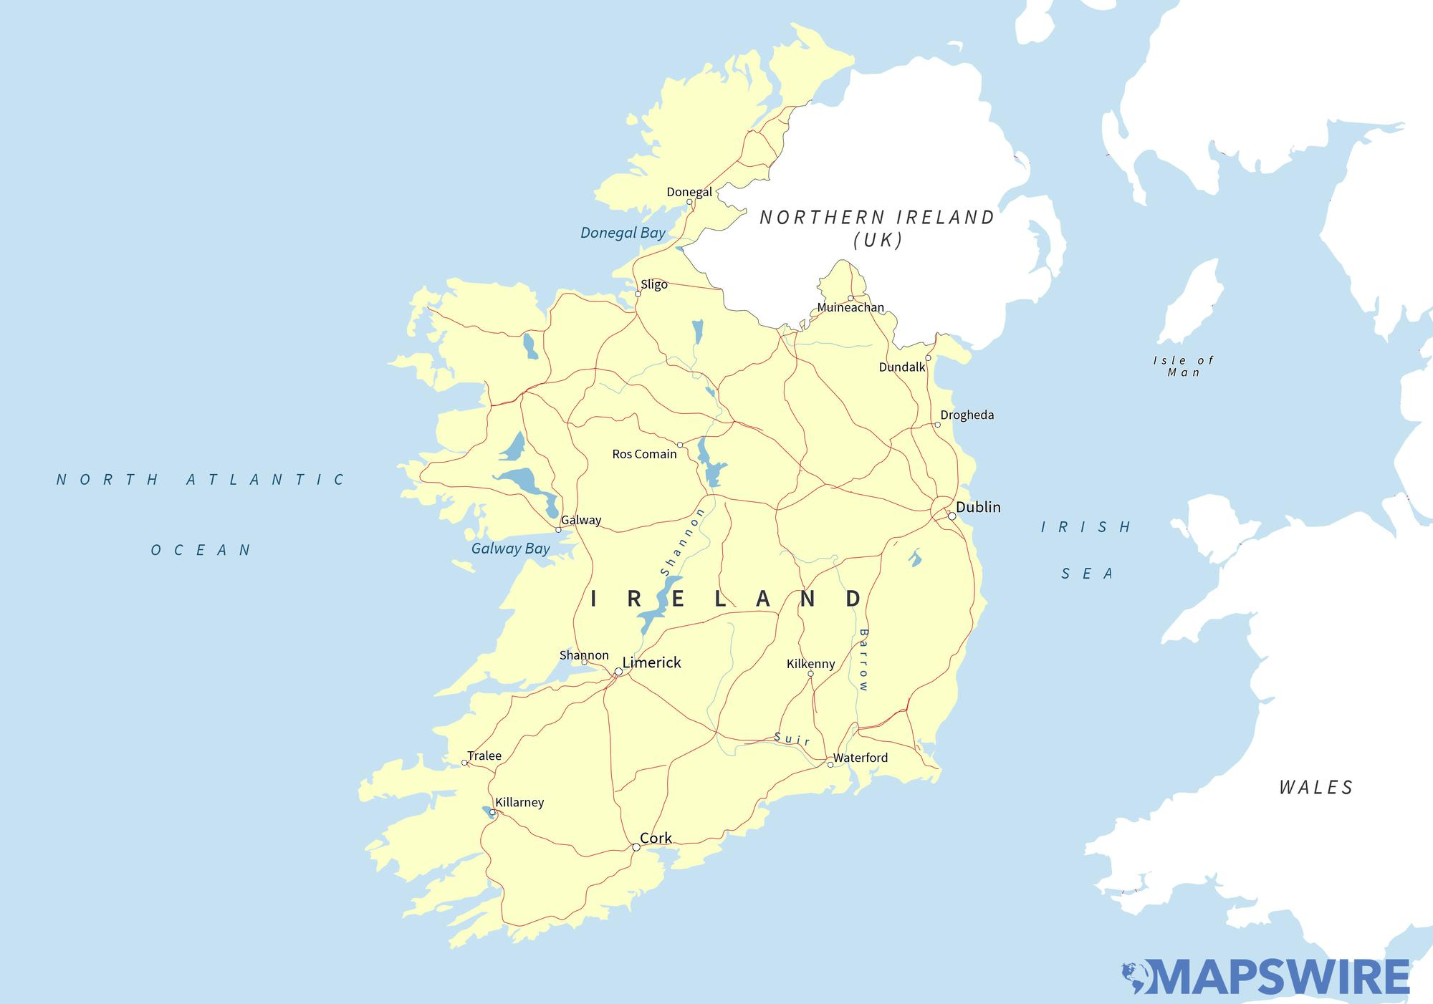
Maps
Can anyone tell me what we use maps for?

Slide 3
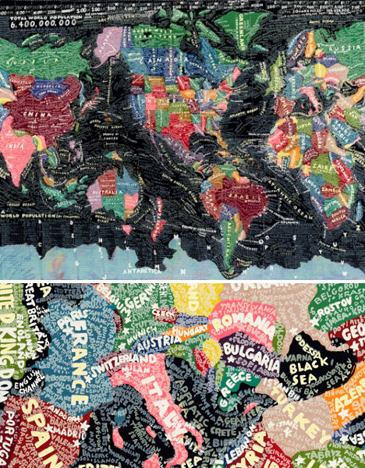
Artists that Use Maps
Paula Scher

Slide 4
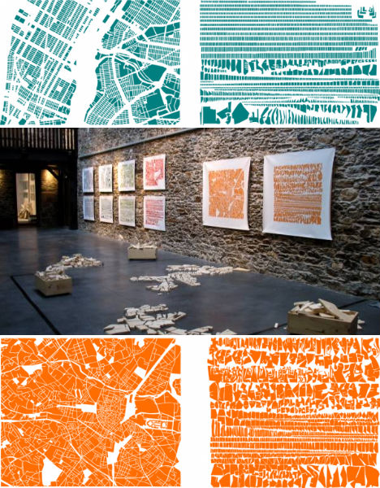
Armelle Caron

Slide 5
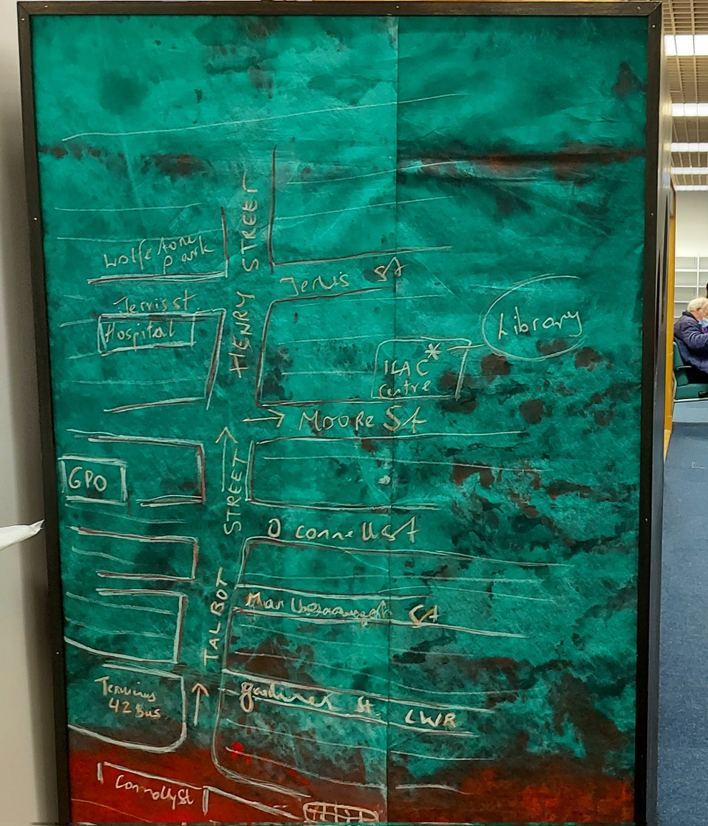
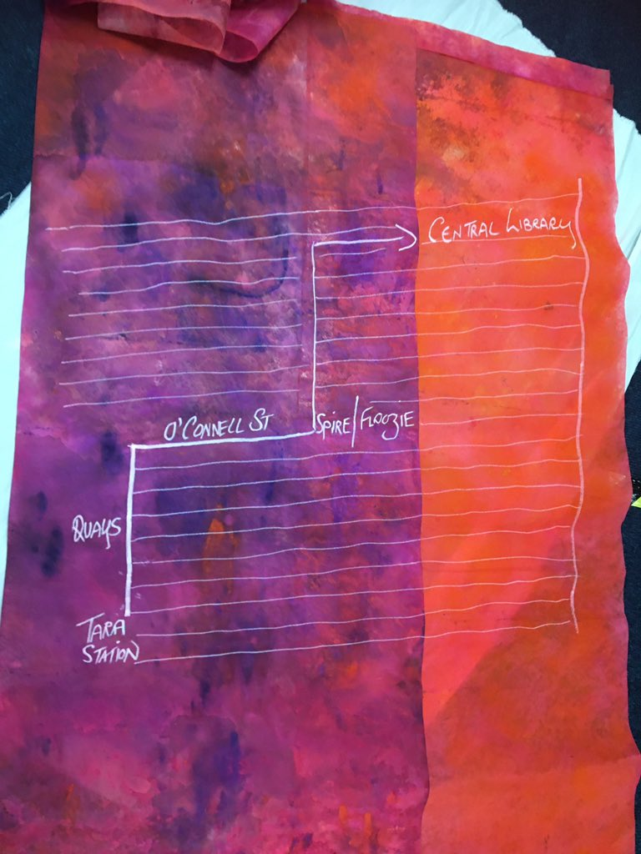
Silvia Loeffler

Slide 6
Today's Tasks
We are going to make our own mark making tool to paint with, using twigs, paper and some other materials
We are going to create blind drawings of our routes from home to school
  First with colourful markers/crayons in our notebooks
  Then on big sheets with our tools
Make another map of home to school while adding symbols on top of our routes
Important Word
Blind Drawing- When we don’t look at the page but we draw what we see

Slide 7
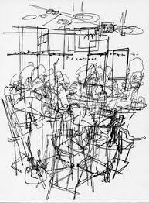
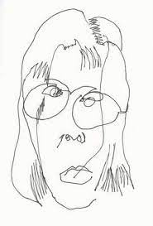
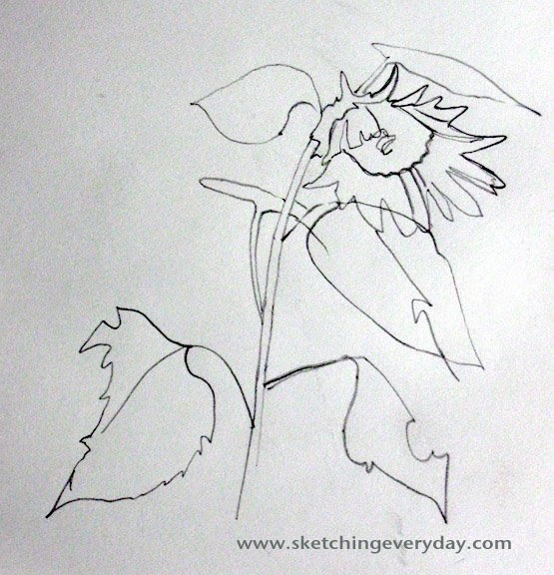
Blind Drawing
Blind Drawing means closing your eyes and not looking at you paper while you draw

Slide 8
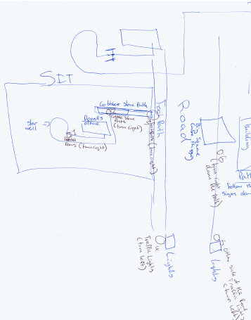
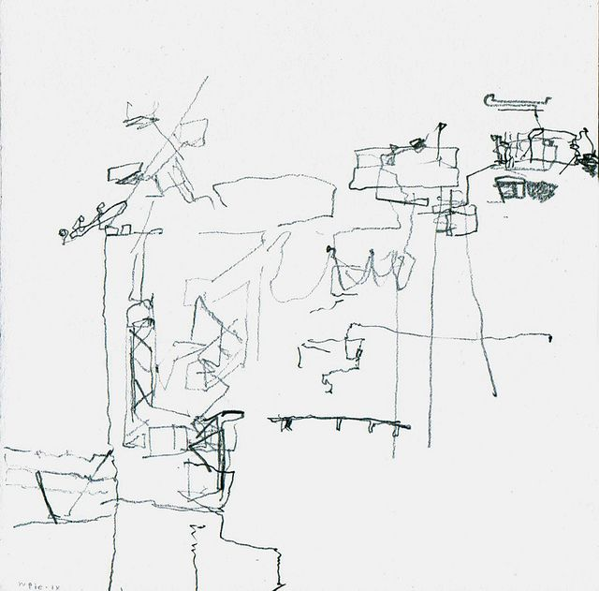
Blind Drawing of Routes

Slide 9
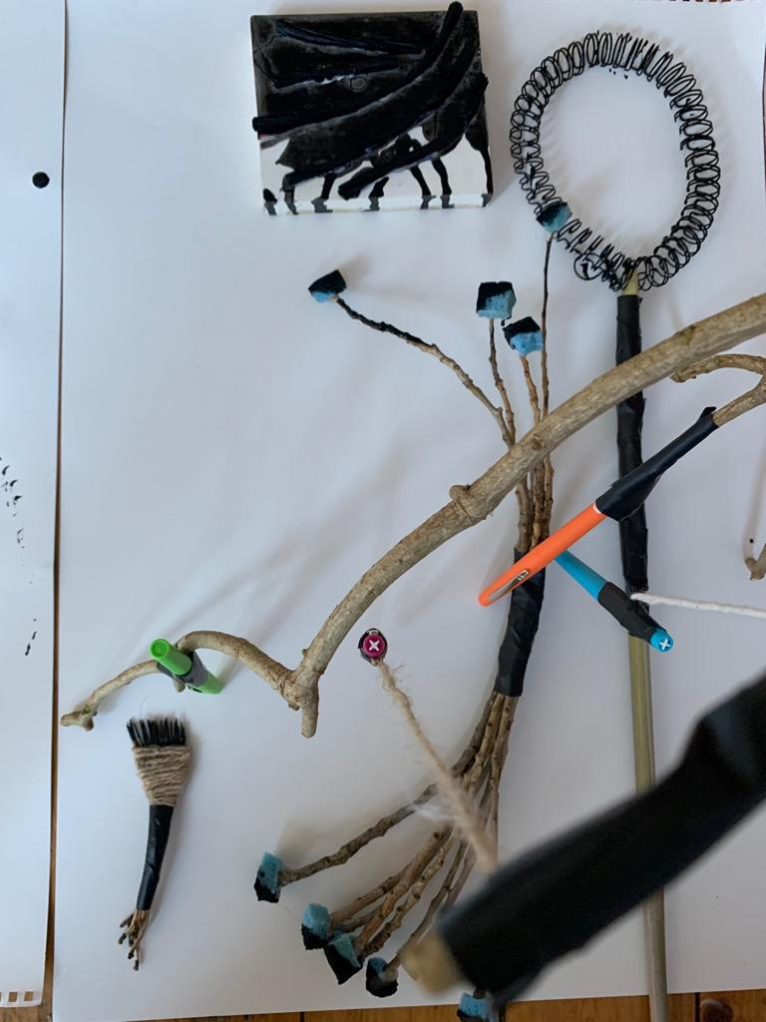
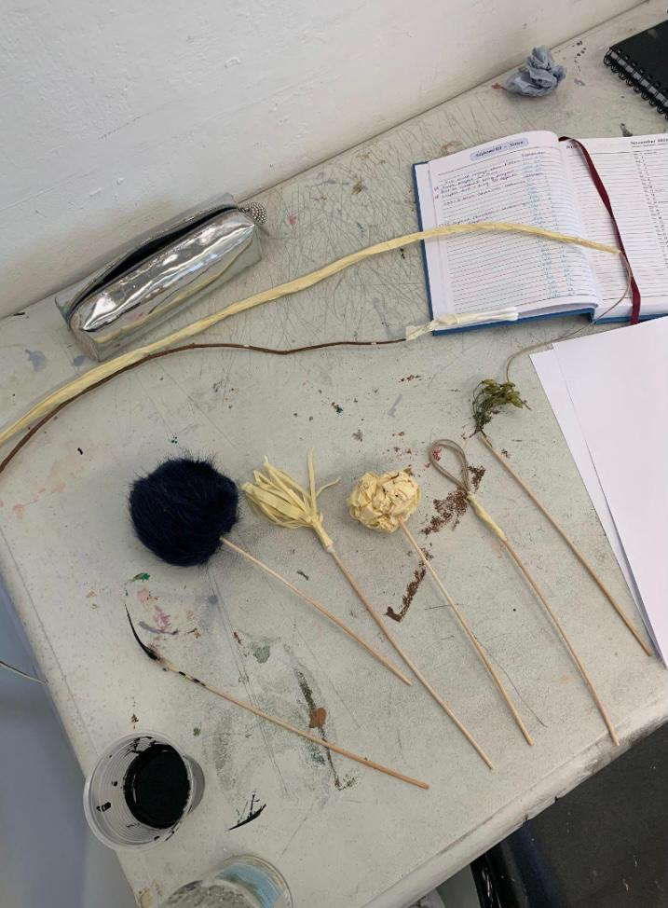
Making your own tools to draw with

